Slide 1
Save a Bit, Shift a Bit, blink a 100 LEDs!
Hollo-deck presentation for the Lab Work
Presented by charmstr

Slide 2
What we are going to see:
An Introduction to Logic gates
What is memory ? how to save a bit
What is a register ? A shift register?
A insight into the basics of Computer architecture
SIPO: Serial in Parallel out
How to Control a lot of LEDs with only 3 control pins

Slide 3
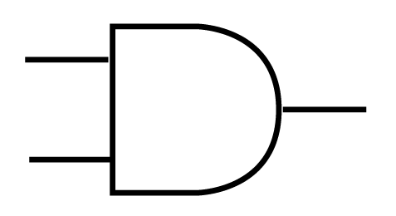
LOGIC GATES
They are the basic of electronic logic circuitry.
AND, OR, NOT, XOR
They do the same logic job as their equivalent in C language…
Example:
if ( a && b )
a == 1 ?
AND
0 or 1
b == 1 ?

Slide 4
We are in +5V today…
a == 1 ?
AND
0 or 1
b == 1 ?
Logic 1?
“HIGH” = near +5V
Logic 0?
“LOW” or near 0V…
In between? What is 2,5V?
/!\ We don’t know /!\ We will see later the “tri-state output”

Slide 5
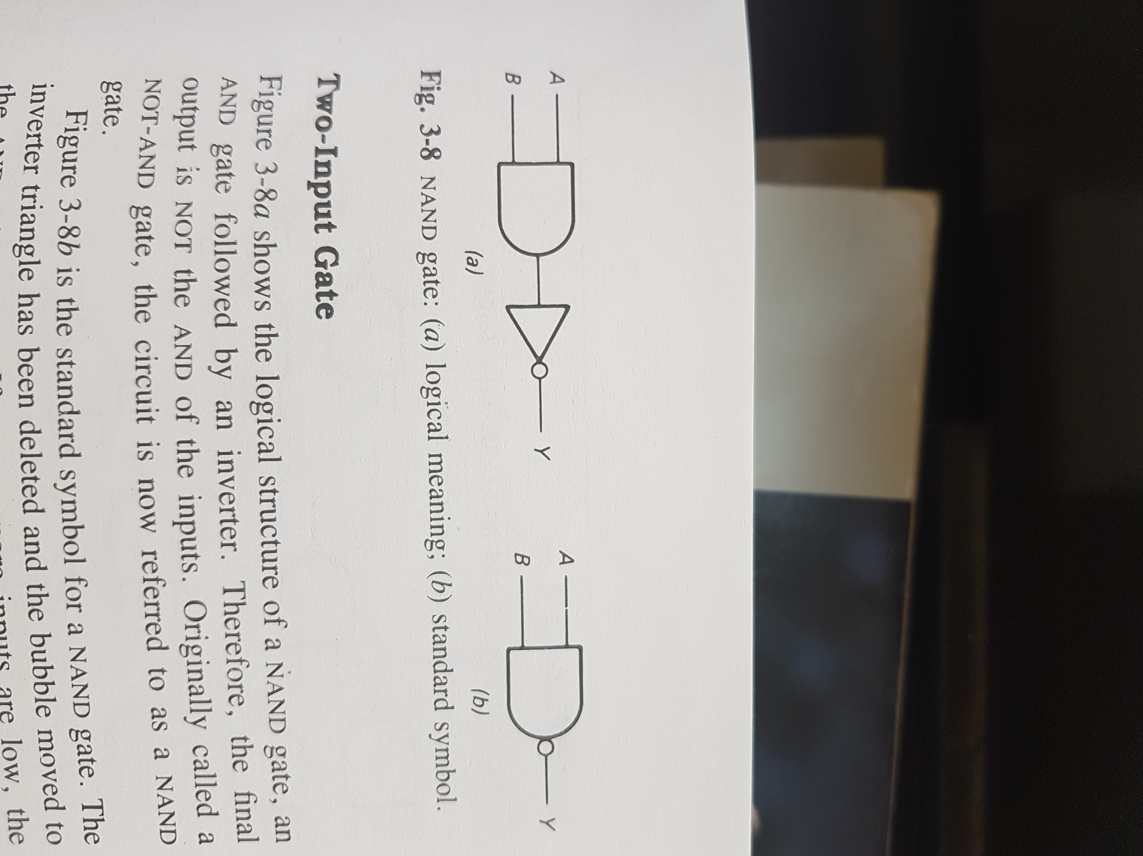
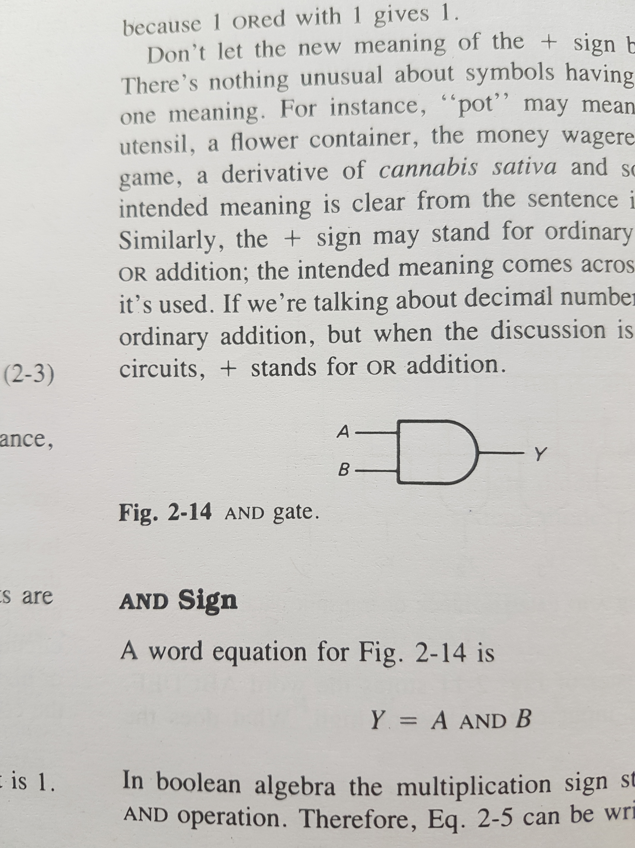
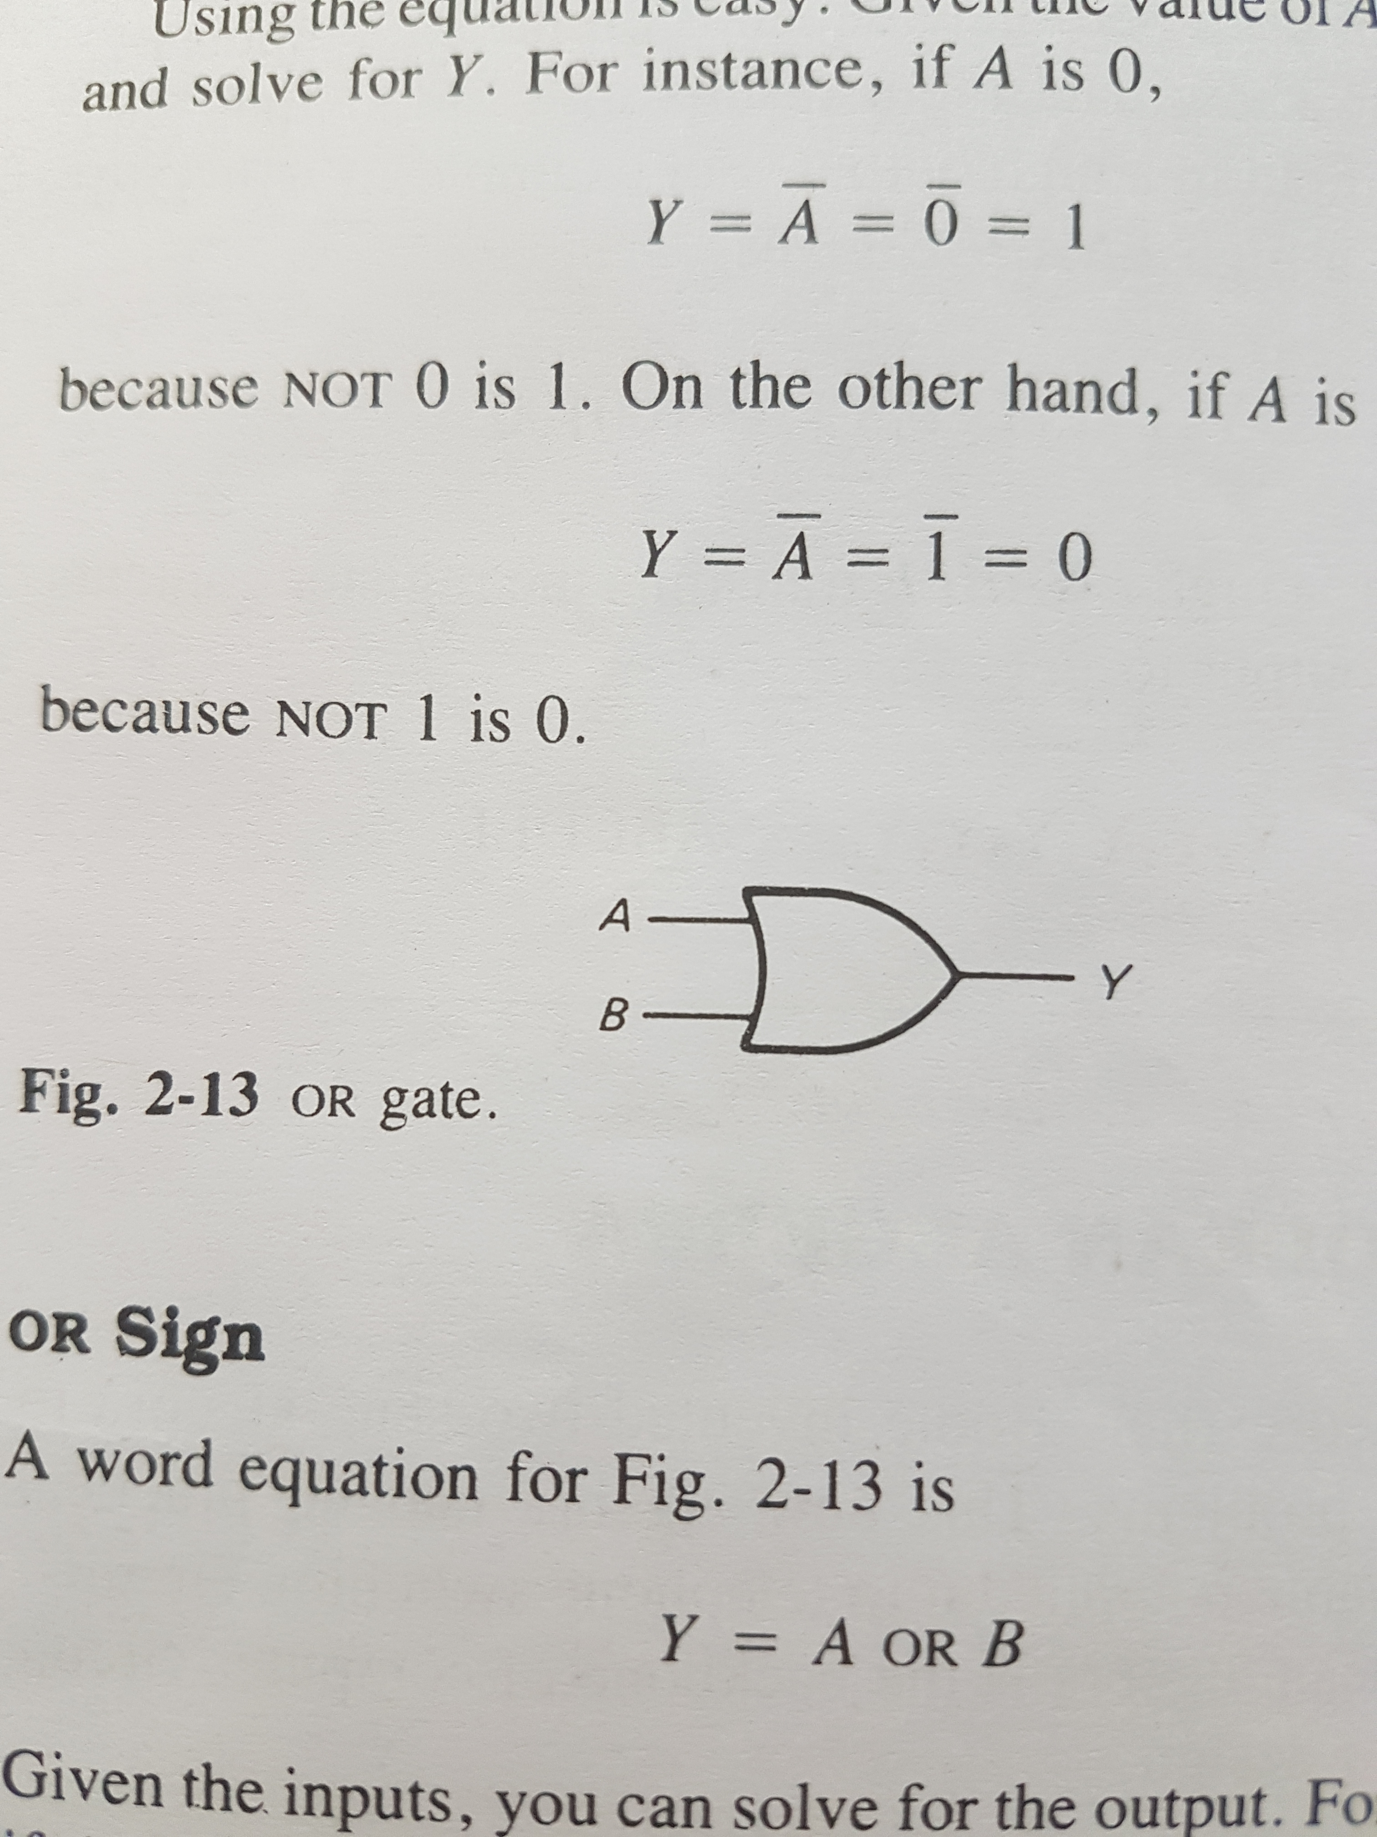
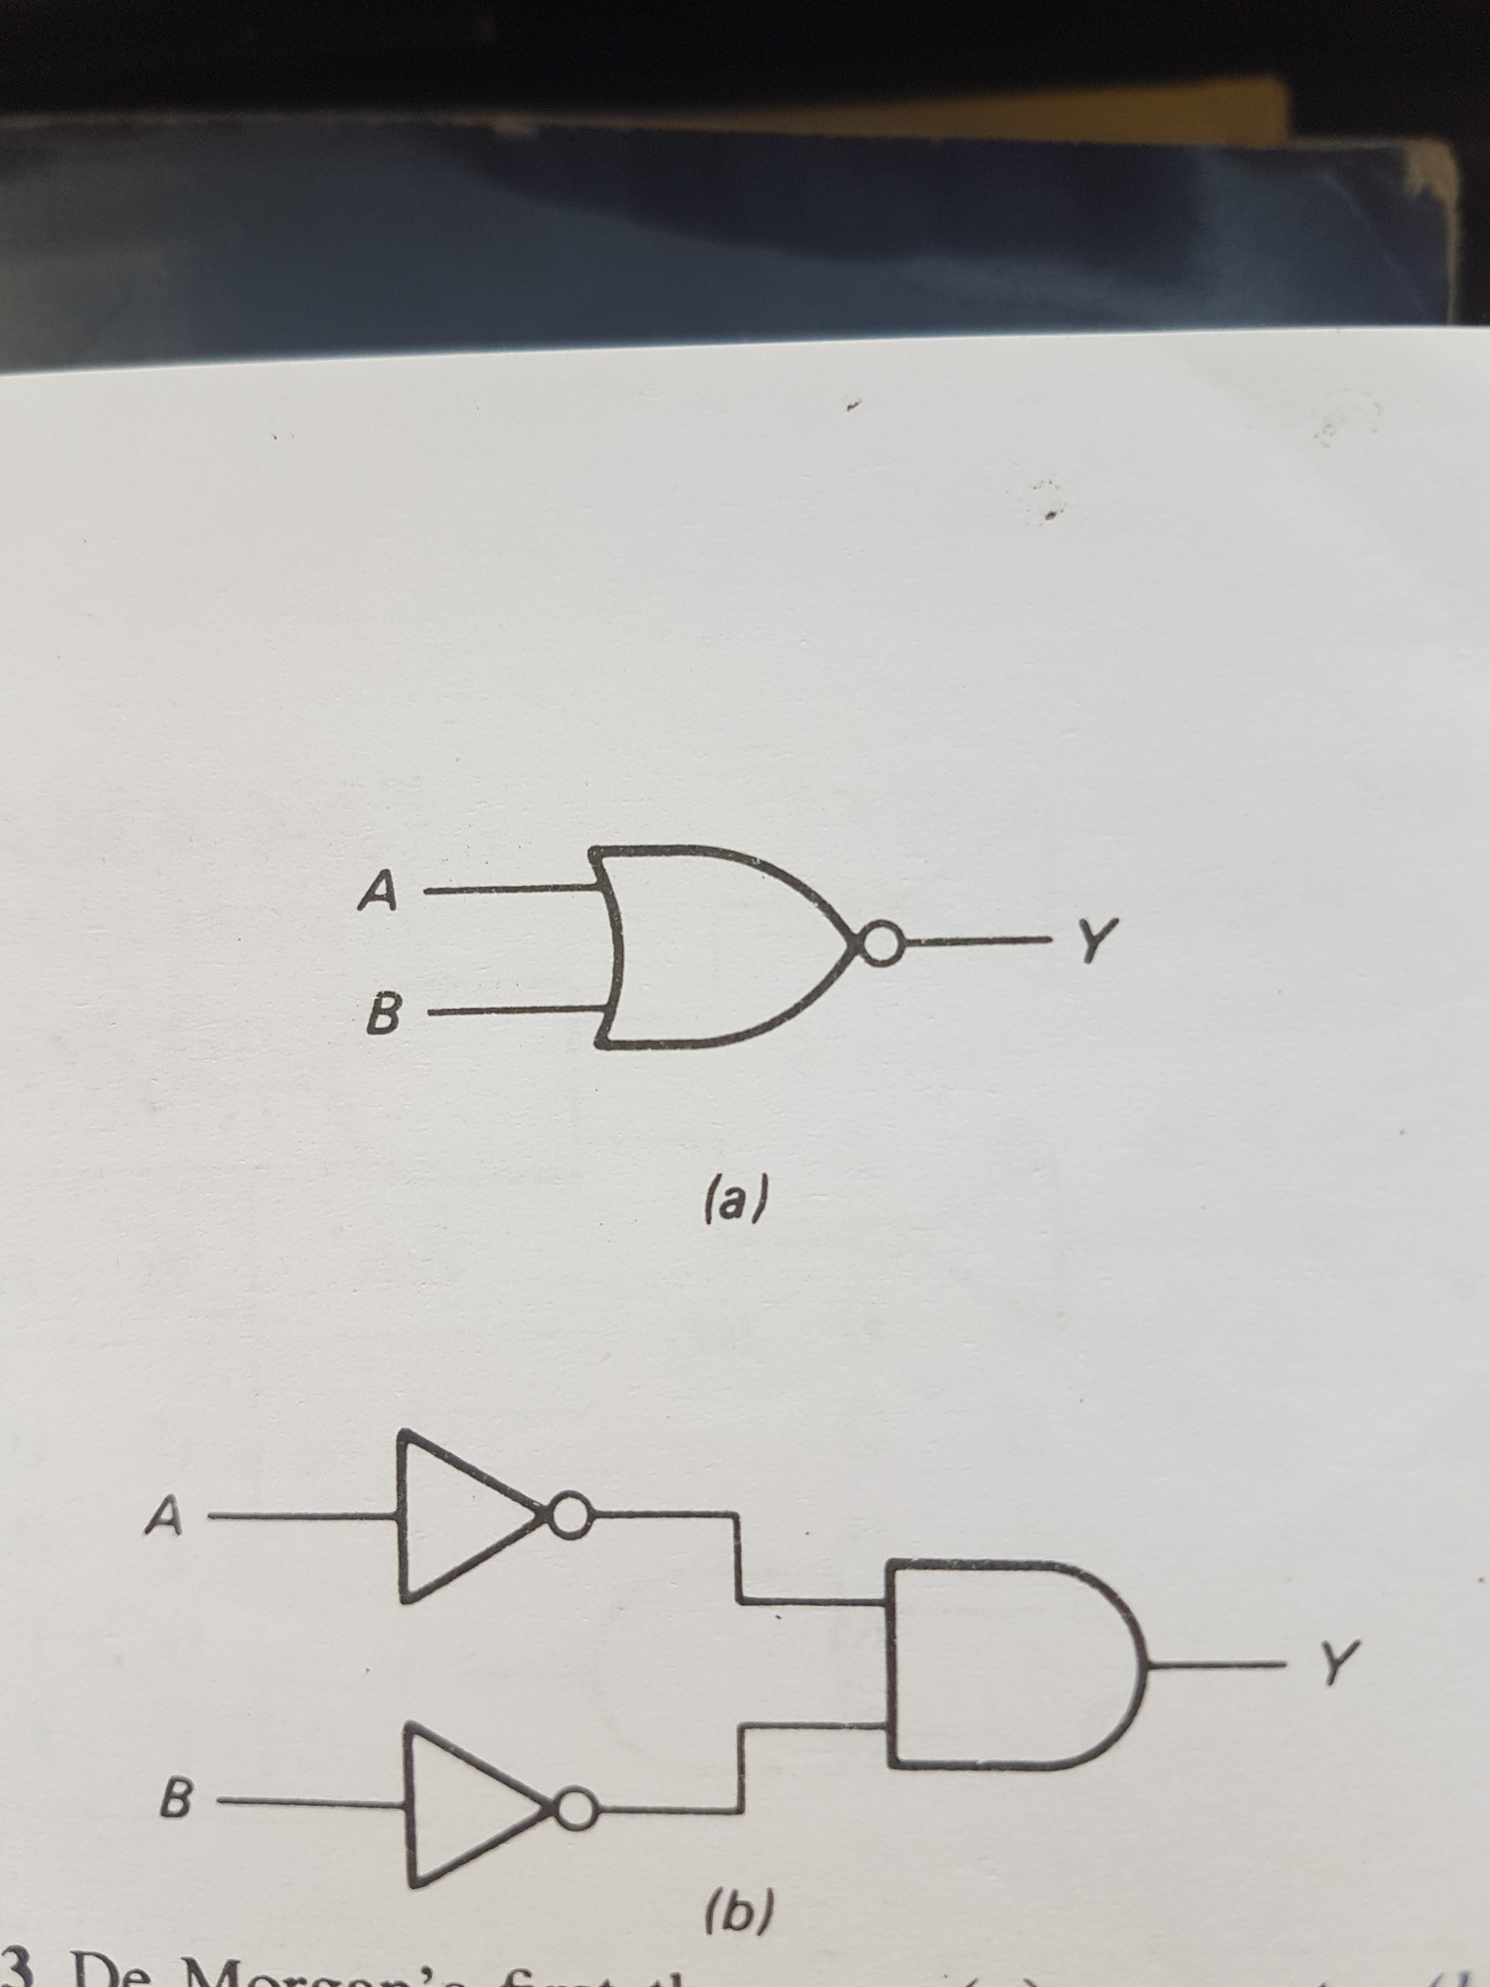
LOGIC GATES SYMBOLS
NOT gate (inverter):
AND gate:
NAND gate:
OR gate:
NOR gate:

Slide 6
What is memory ? how to save a bit

Slide 7
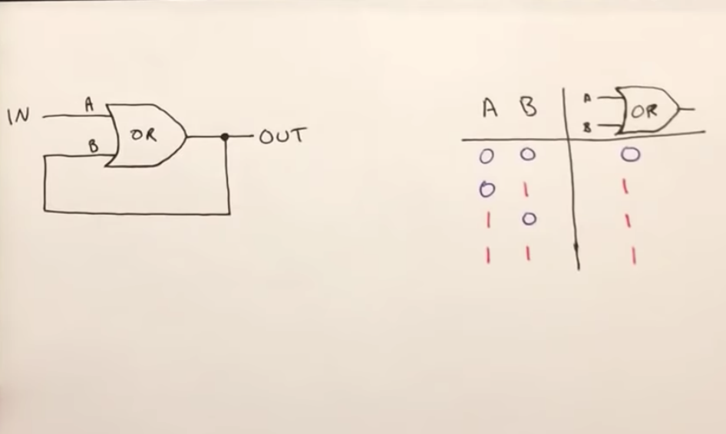
NOR latch introduction
video from Ben eater’s YouTube channel (play between 02:00 and 03:42):
https://www.youtube.com/watch?v=KM0DdEaY5sY

Slide 8

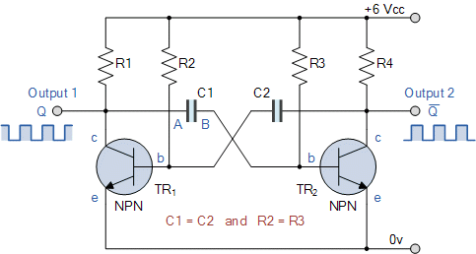
REMEMBER?
The astable multi-vibrator

Slide 9
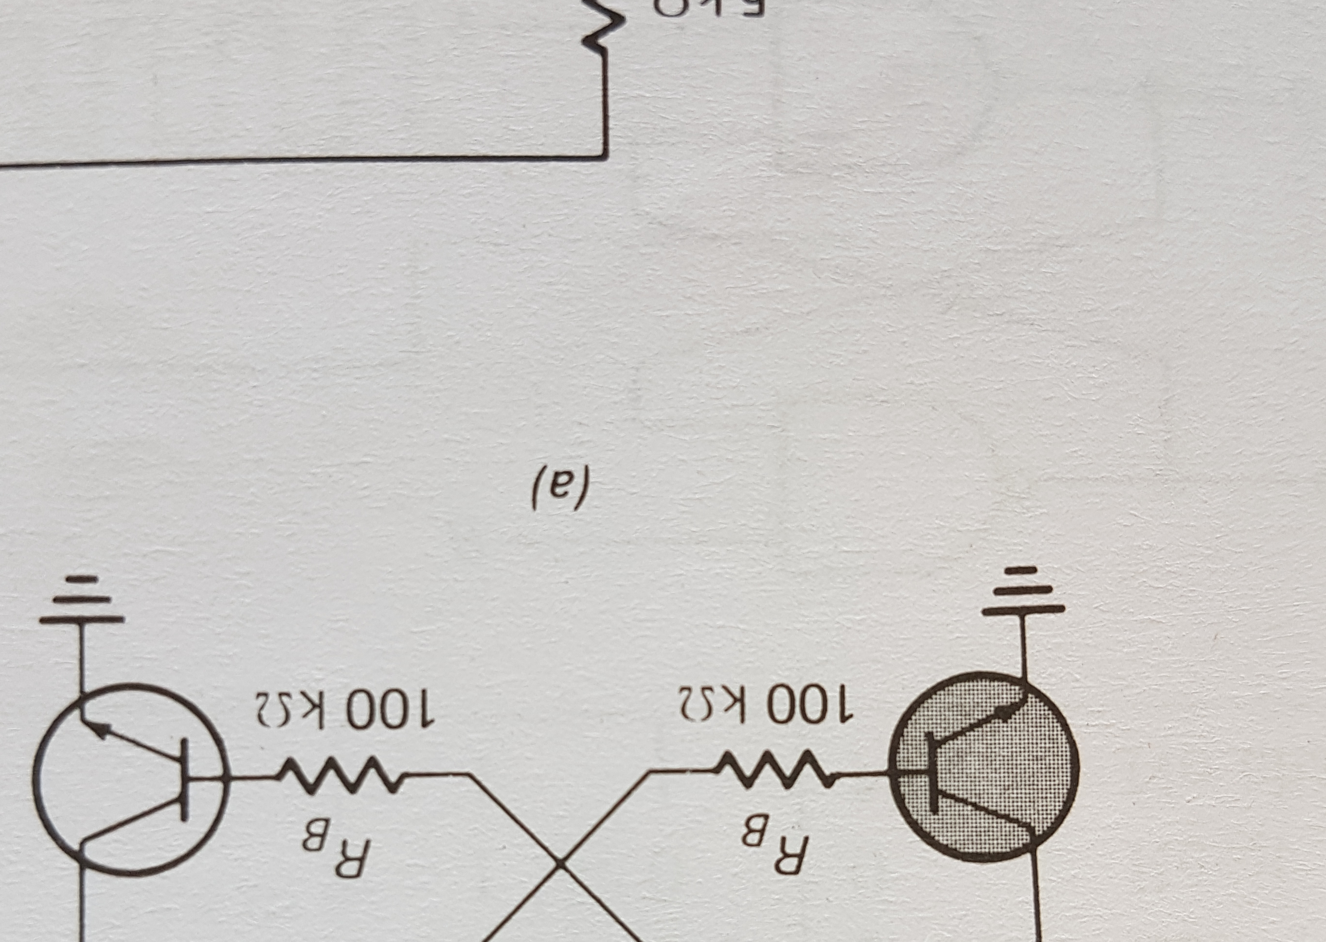
Bi-stable multi-vibrator
It has two absolutely stable states
It is also called a flip-flop, trigger circuit or binary

Slide 10




+5V
HIGH
OUTPUT ?
+5V
0V (Ground)
0V
Ground
Latched/stable state

Slide 11
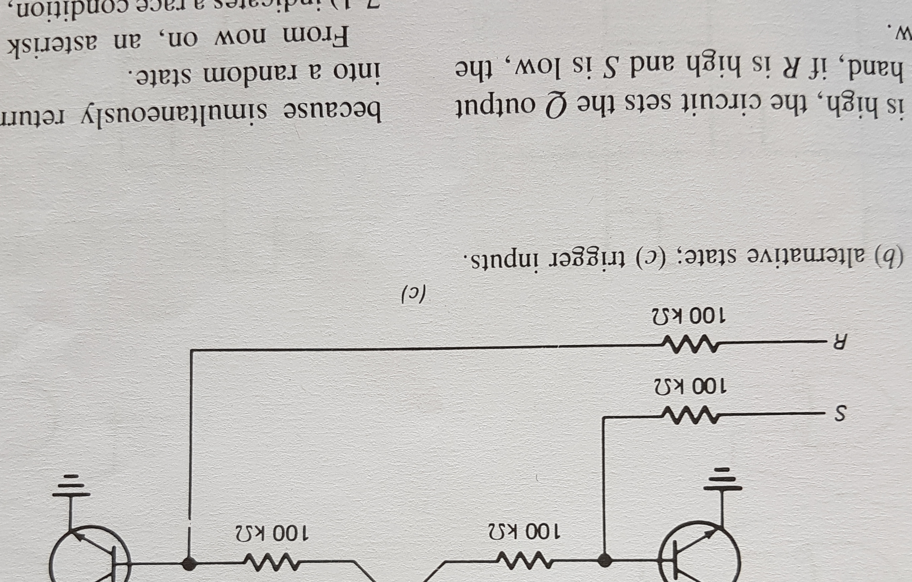
SET
RESET
We can set and Reset: Bi-stable

Slide 12
Lets forget about transistors… and just use logic circuits
We will use components from the 74 series.(ex: SN7400, 74LVxx…)
Originally started by Texas Instrument and then adopted as a standard among other manufacturers.
This is old school.

Slide 13
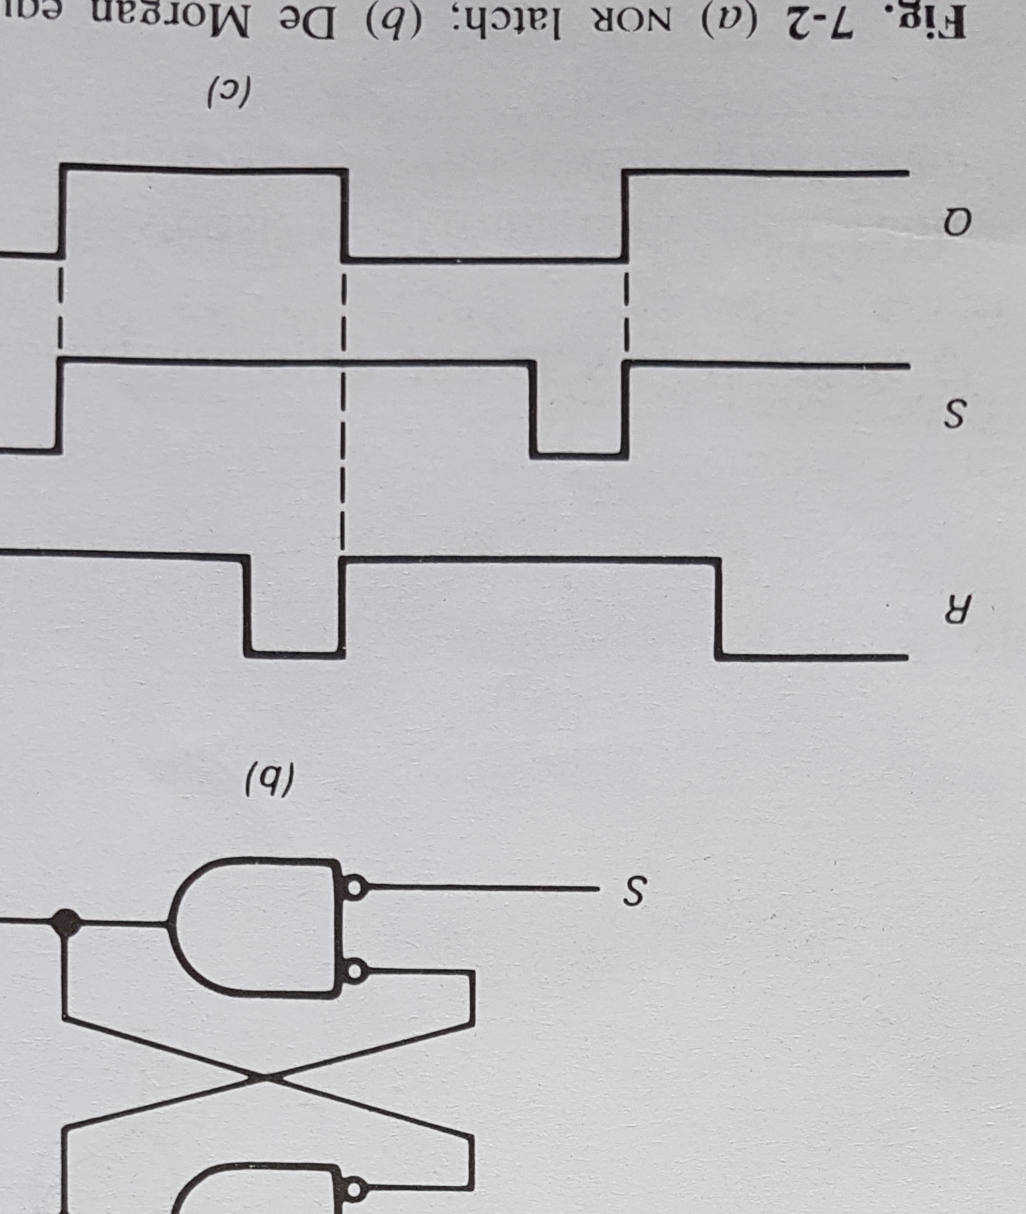
Lets say we start in this situation
If Reset does not change to go HIGH…
The OUTPUT Q will stay HIGH forever*
inversion
0V
Q is going to be the bit we save in memory: 0 OR 1
Imagine Q is HIGH at the very start
INPUTS
OUTPUTS
If Set is toggled, it does not change anything
1 OR 1 …
1 OR 0 …
Therefore inverted Q is LOW
0V
Lets forget about inverted Q
inversion
NOR = OR + NOT

Slide 14
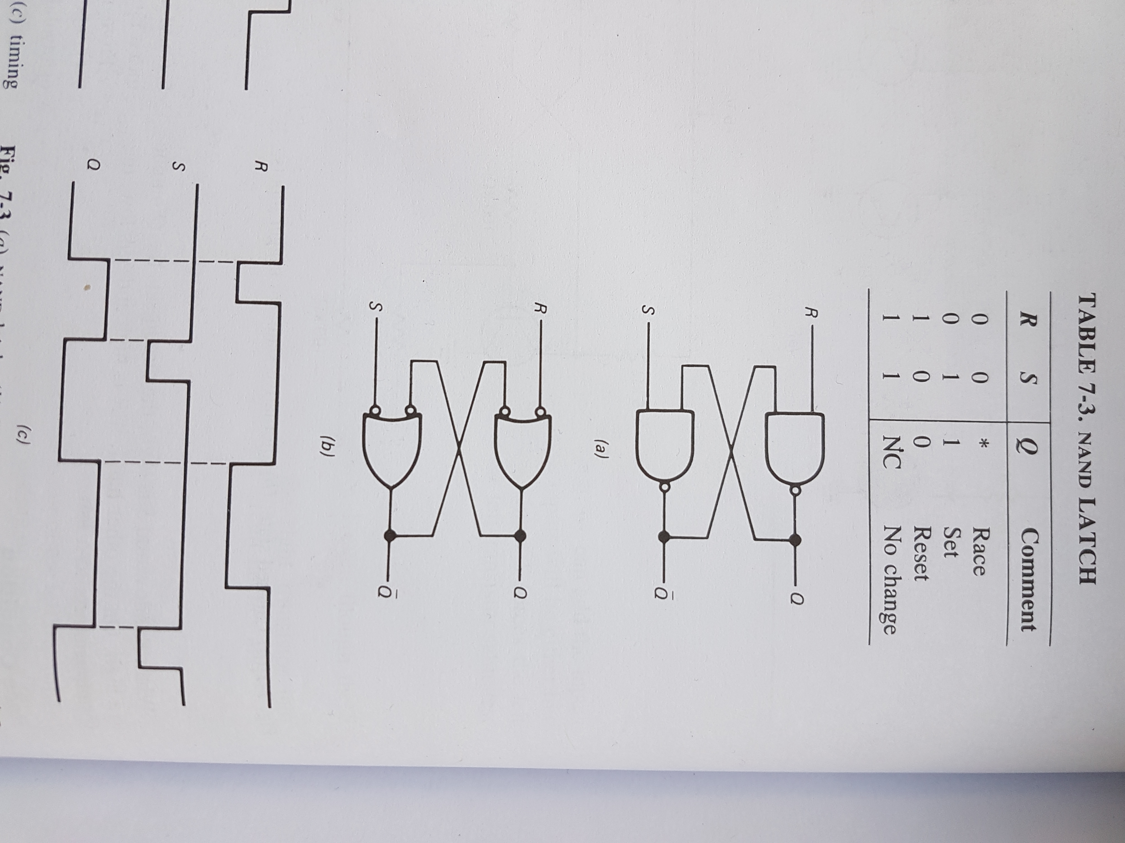
Today you will build a LATCH with NAND gates
Equivalent circuit
/!\ be careful: Not + OR NOR
We will use it in the next slides…

Slide 15
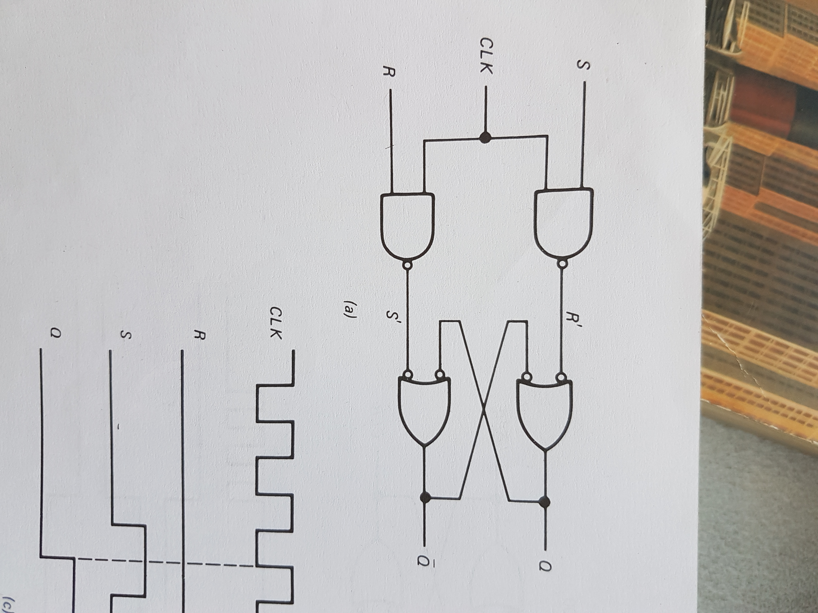
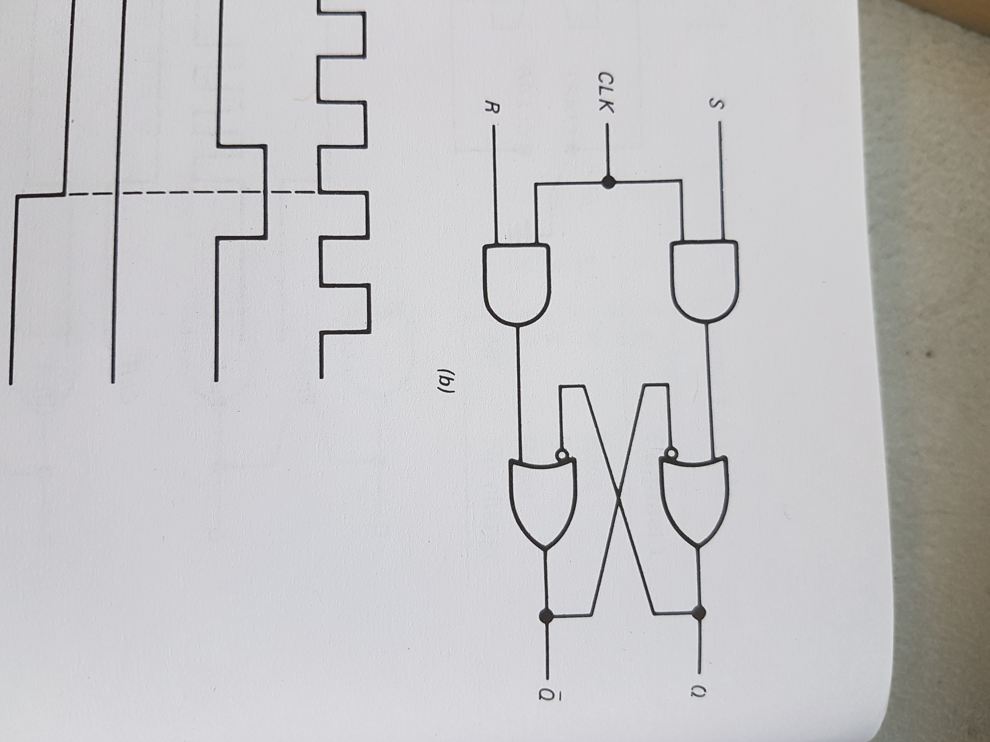
a bit in memory OK, we need a clock signal
Our latch
We just need to add AND gates!
But NAND gates are cheaper.
Two inversions in a raw cancel each other in Boolean Logic.
But realistically there is still a delay… (in nano seconds, see documentation)

Slide 16
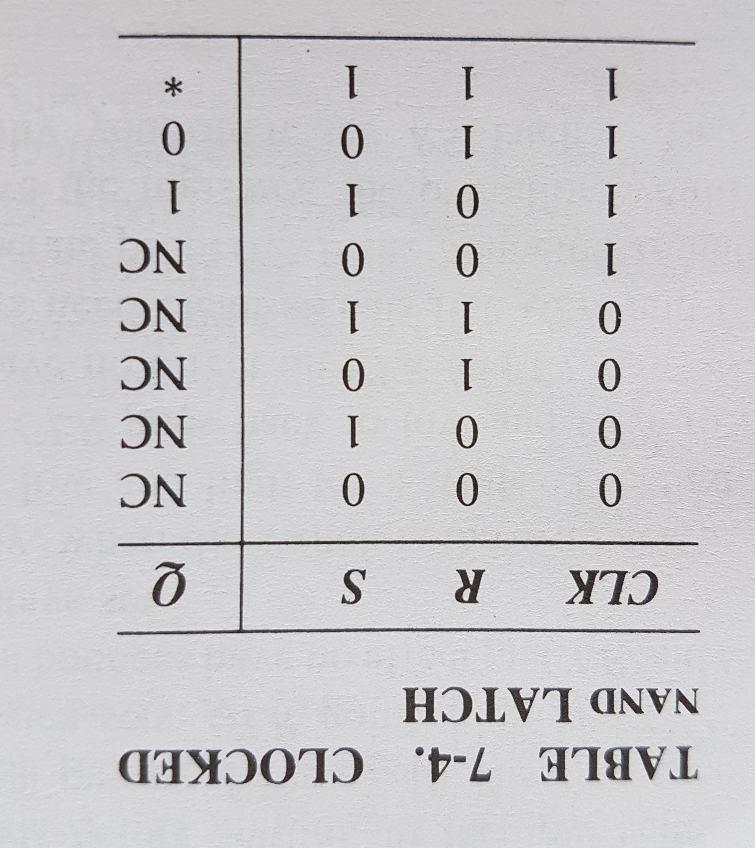


Slide 17
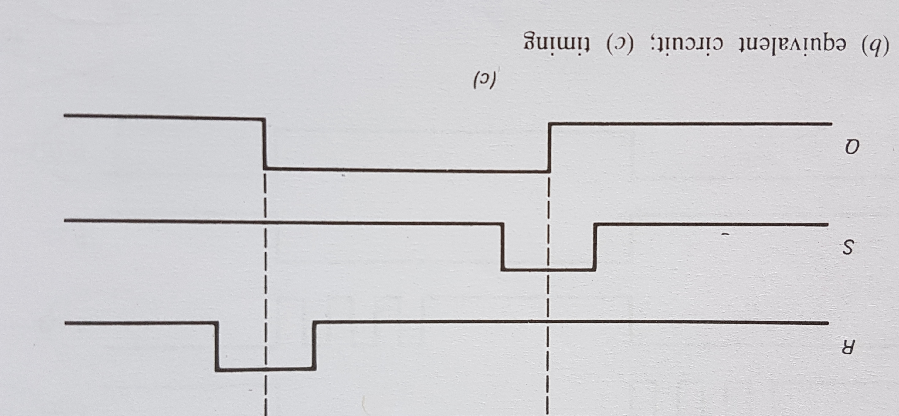
AND
OR

Slide 18
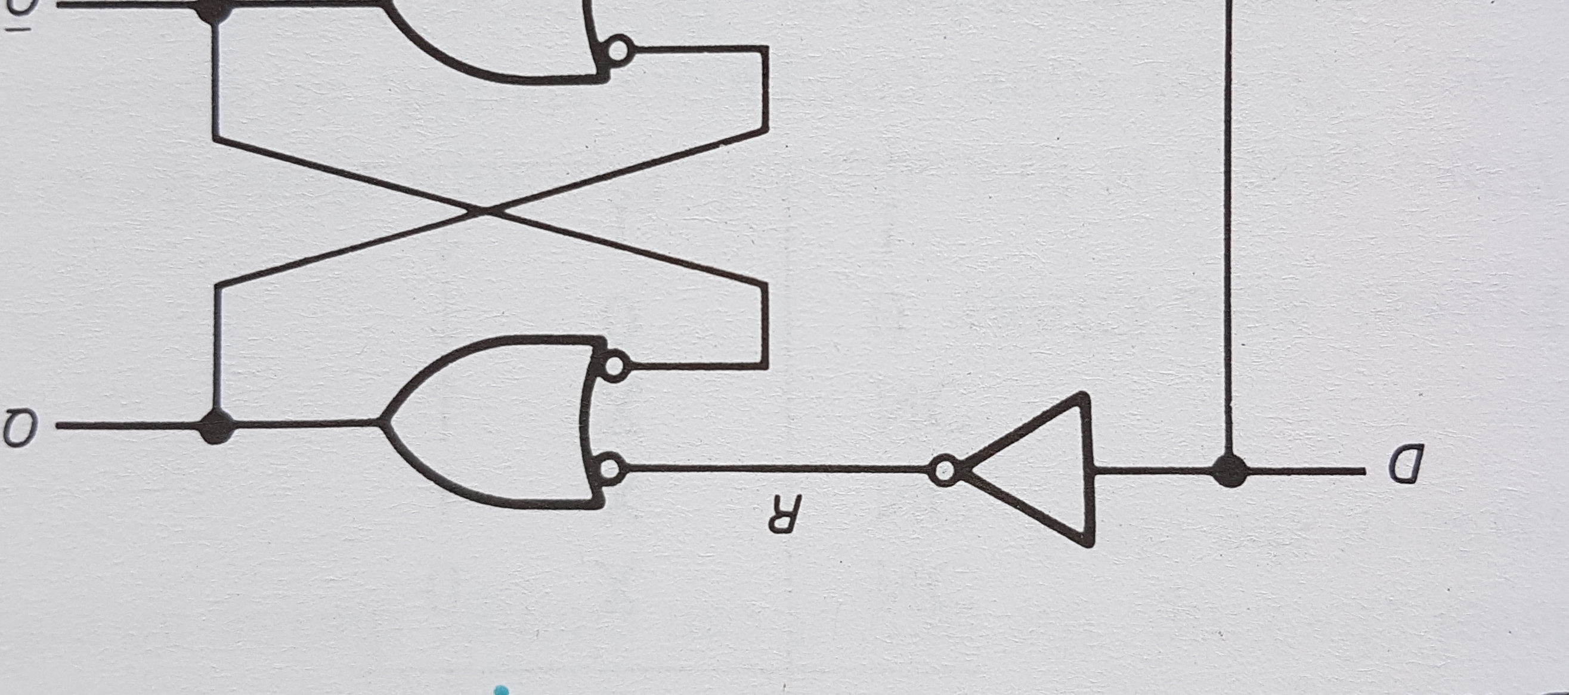
The D latch
Since the RS flip flop is susceptible to a race condition …

Slide 19
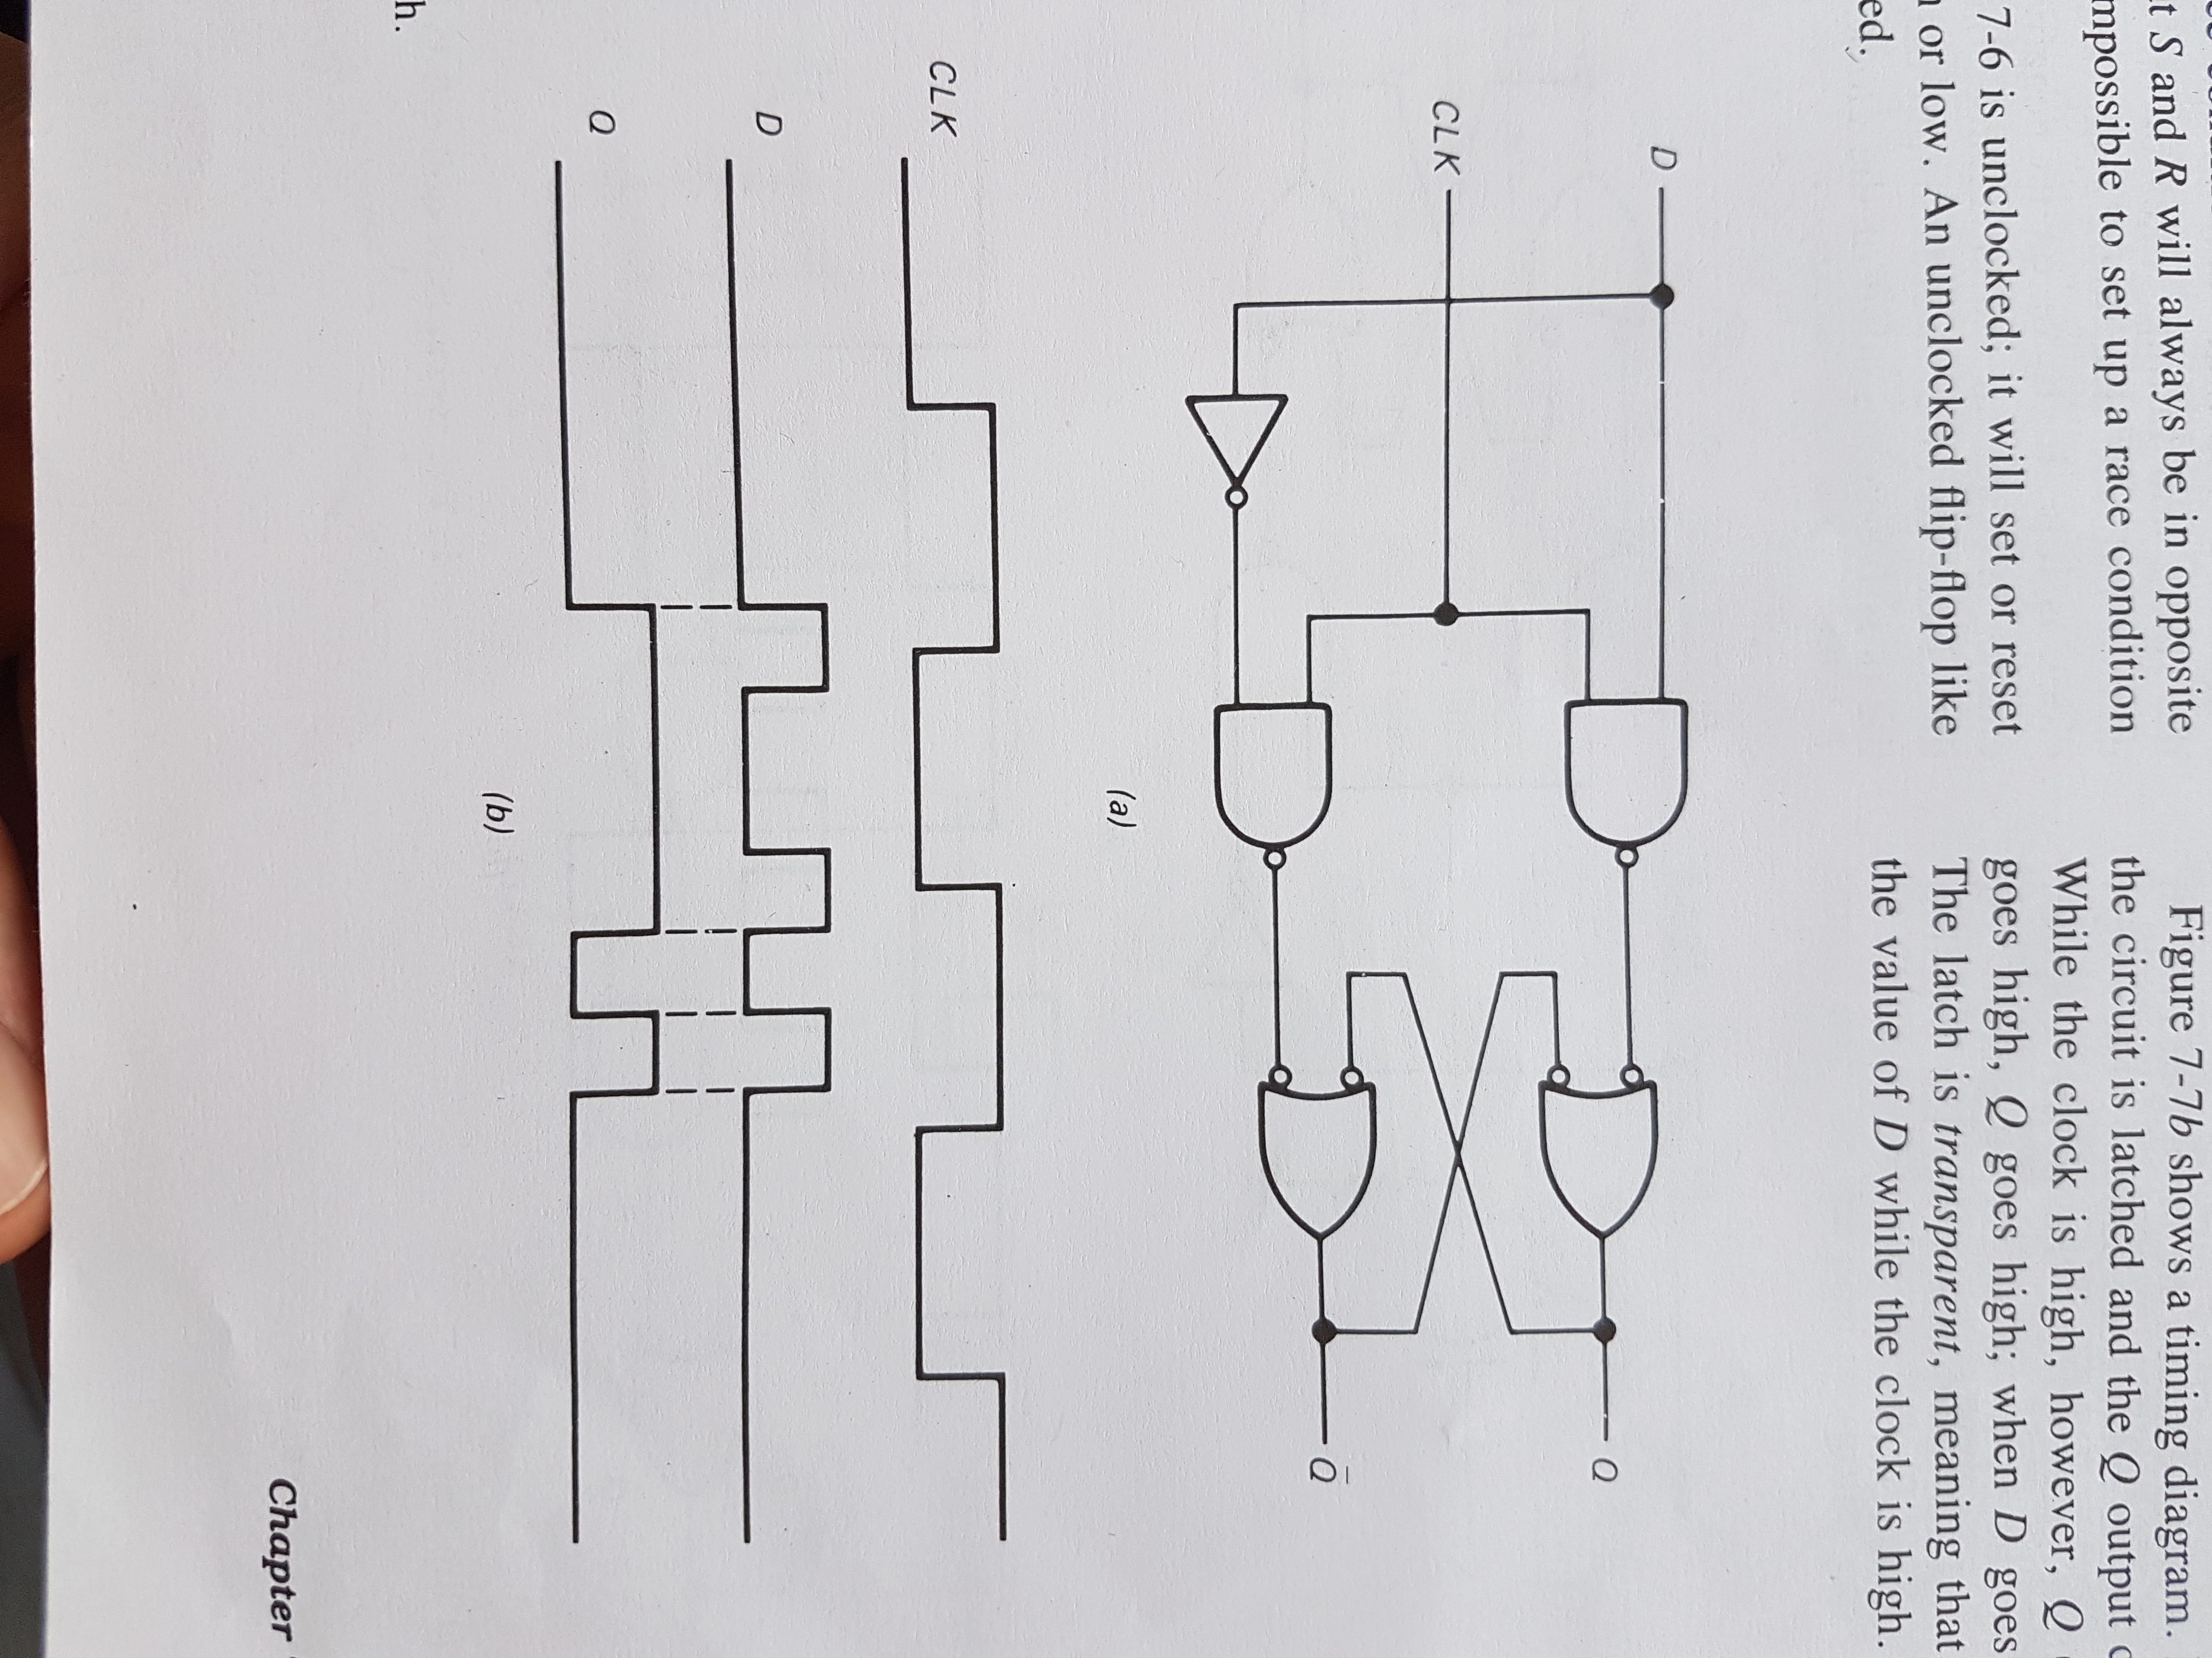
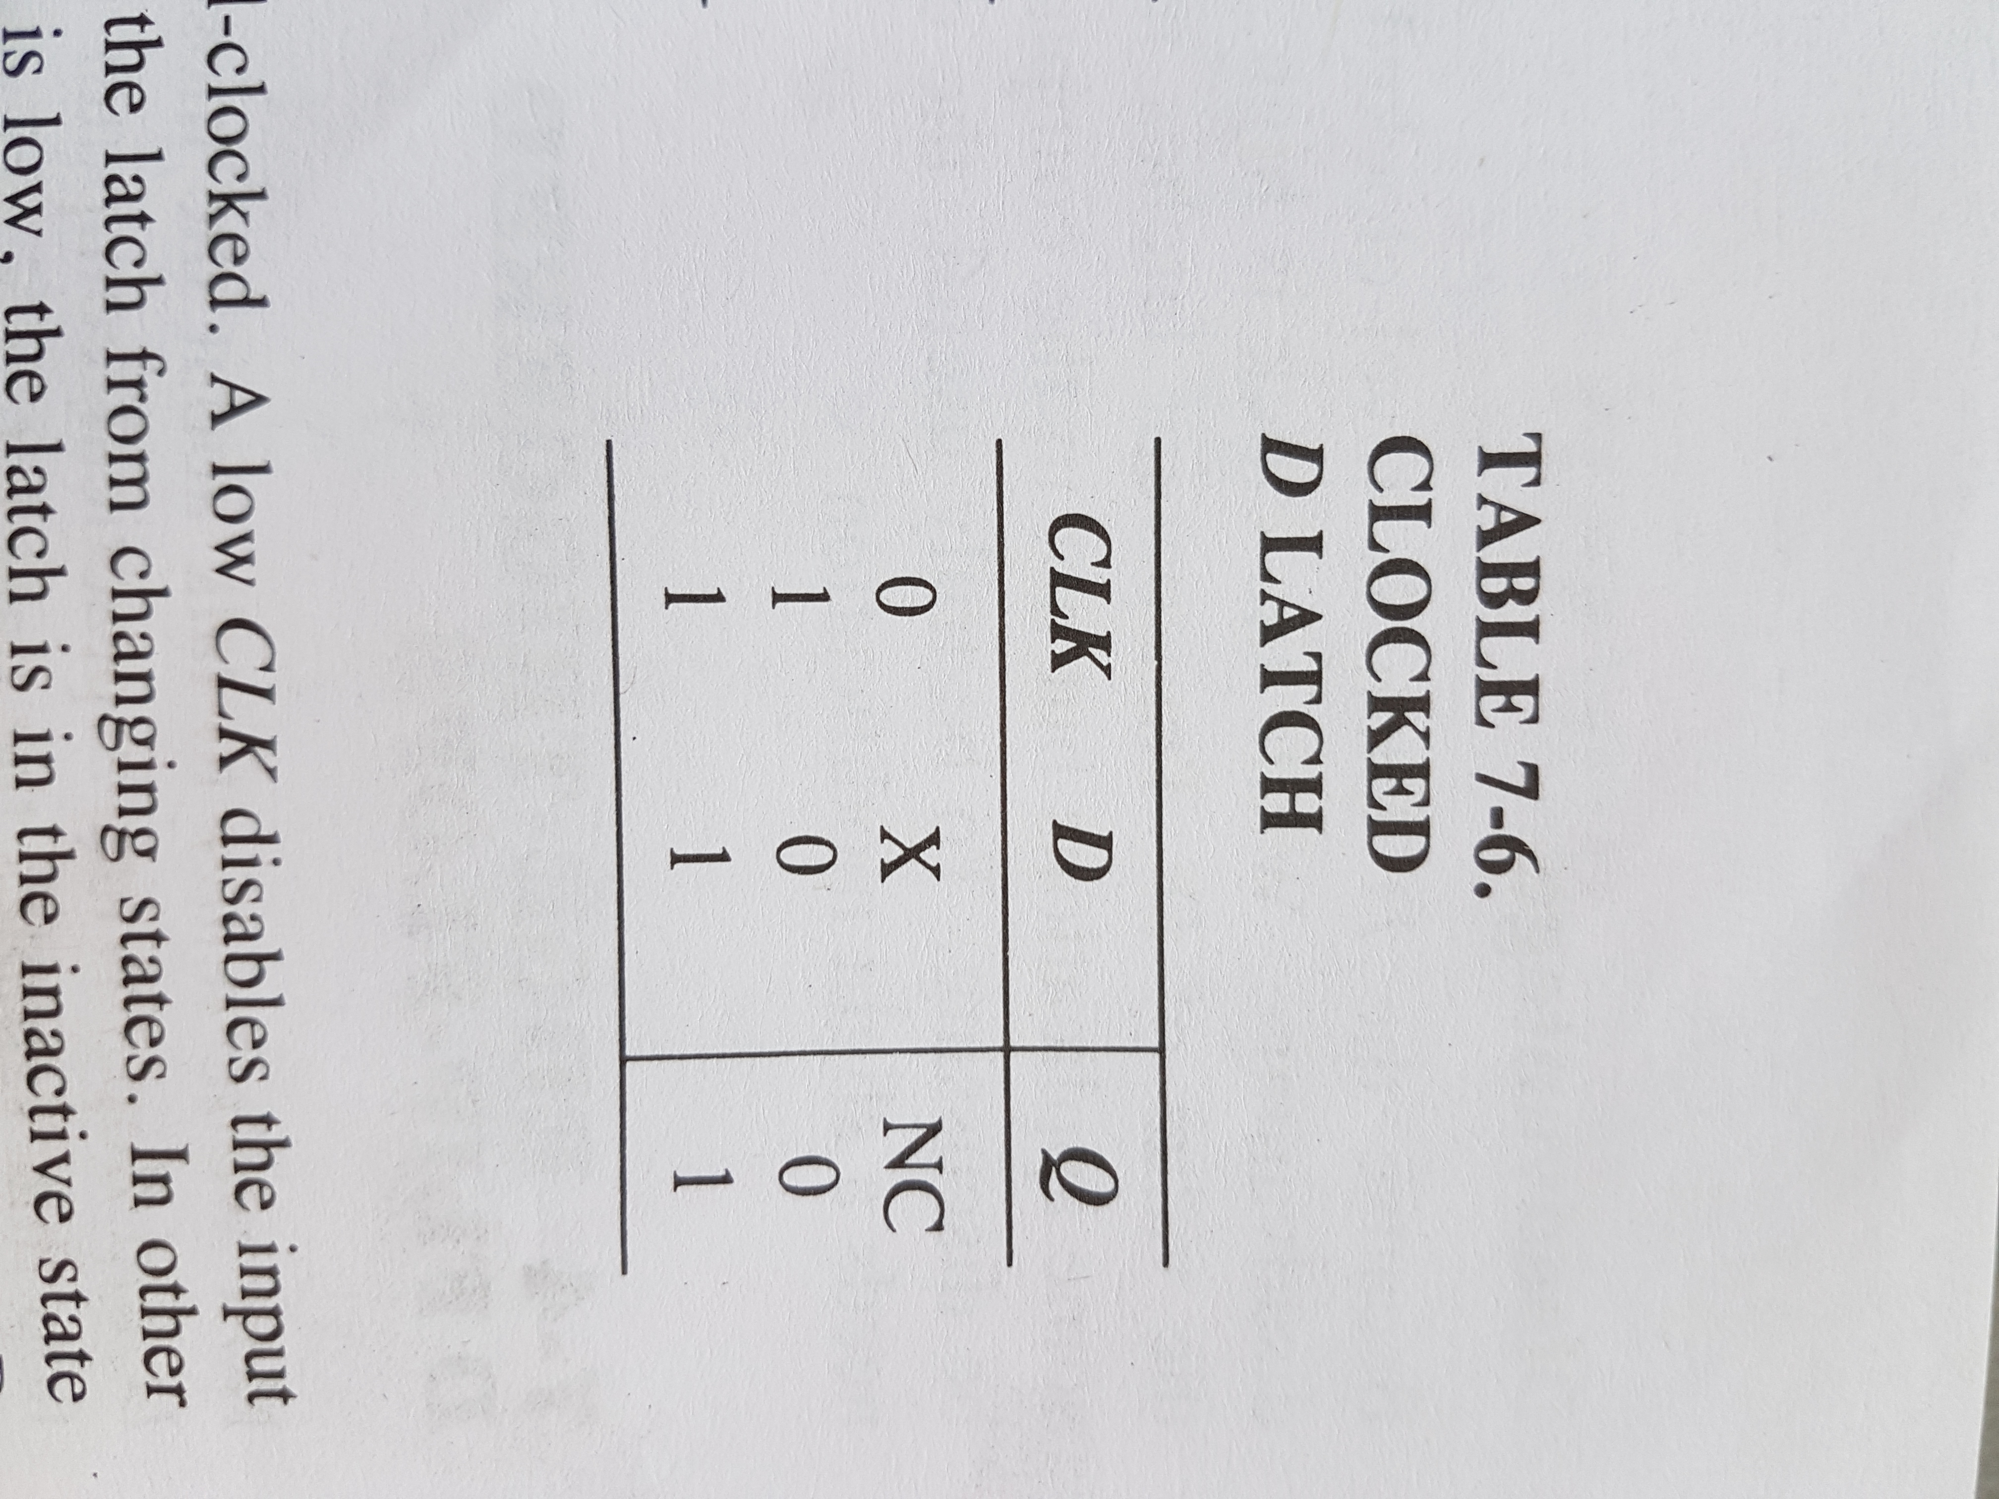
Clocked D latch
Nothing really new.
Now we have just one input in our diagram.

Slide 20
The need for Edge-triggered lacthing
One clock cycle, and several changes in the Q Output → We don’t want that.

Slide 21
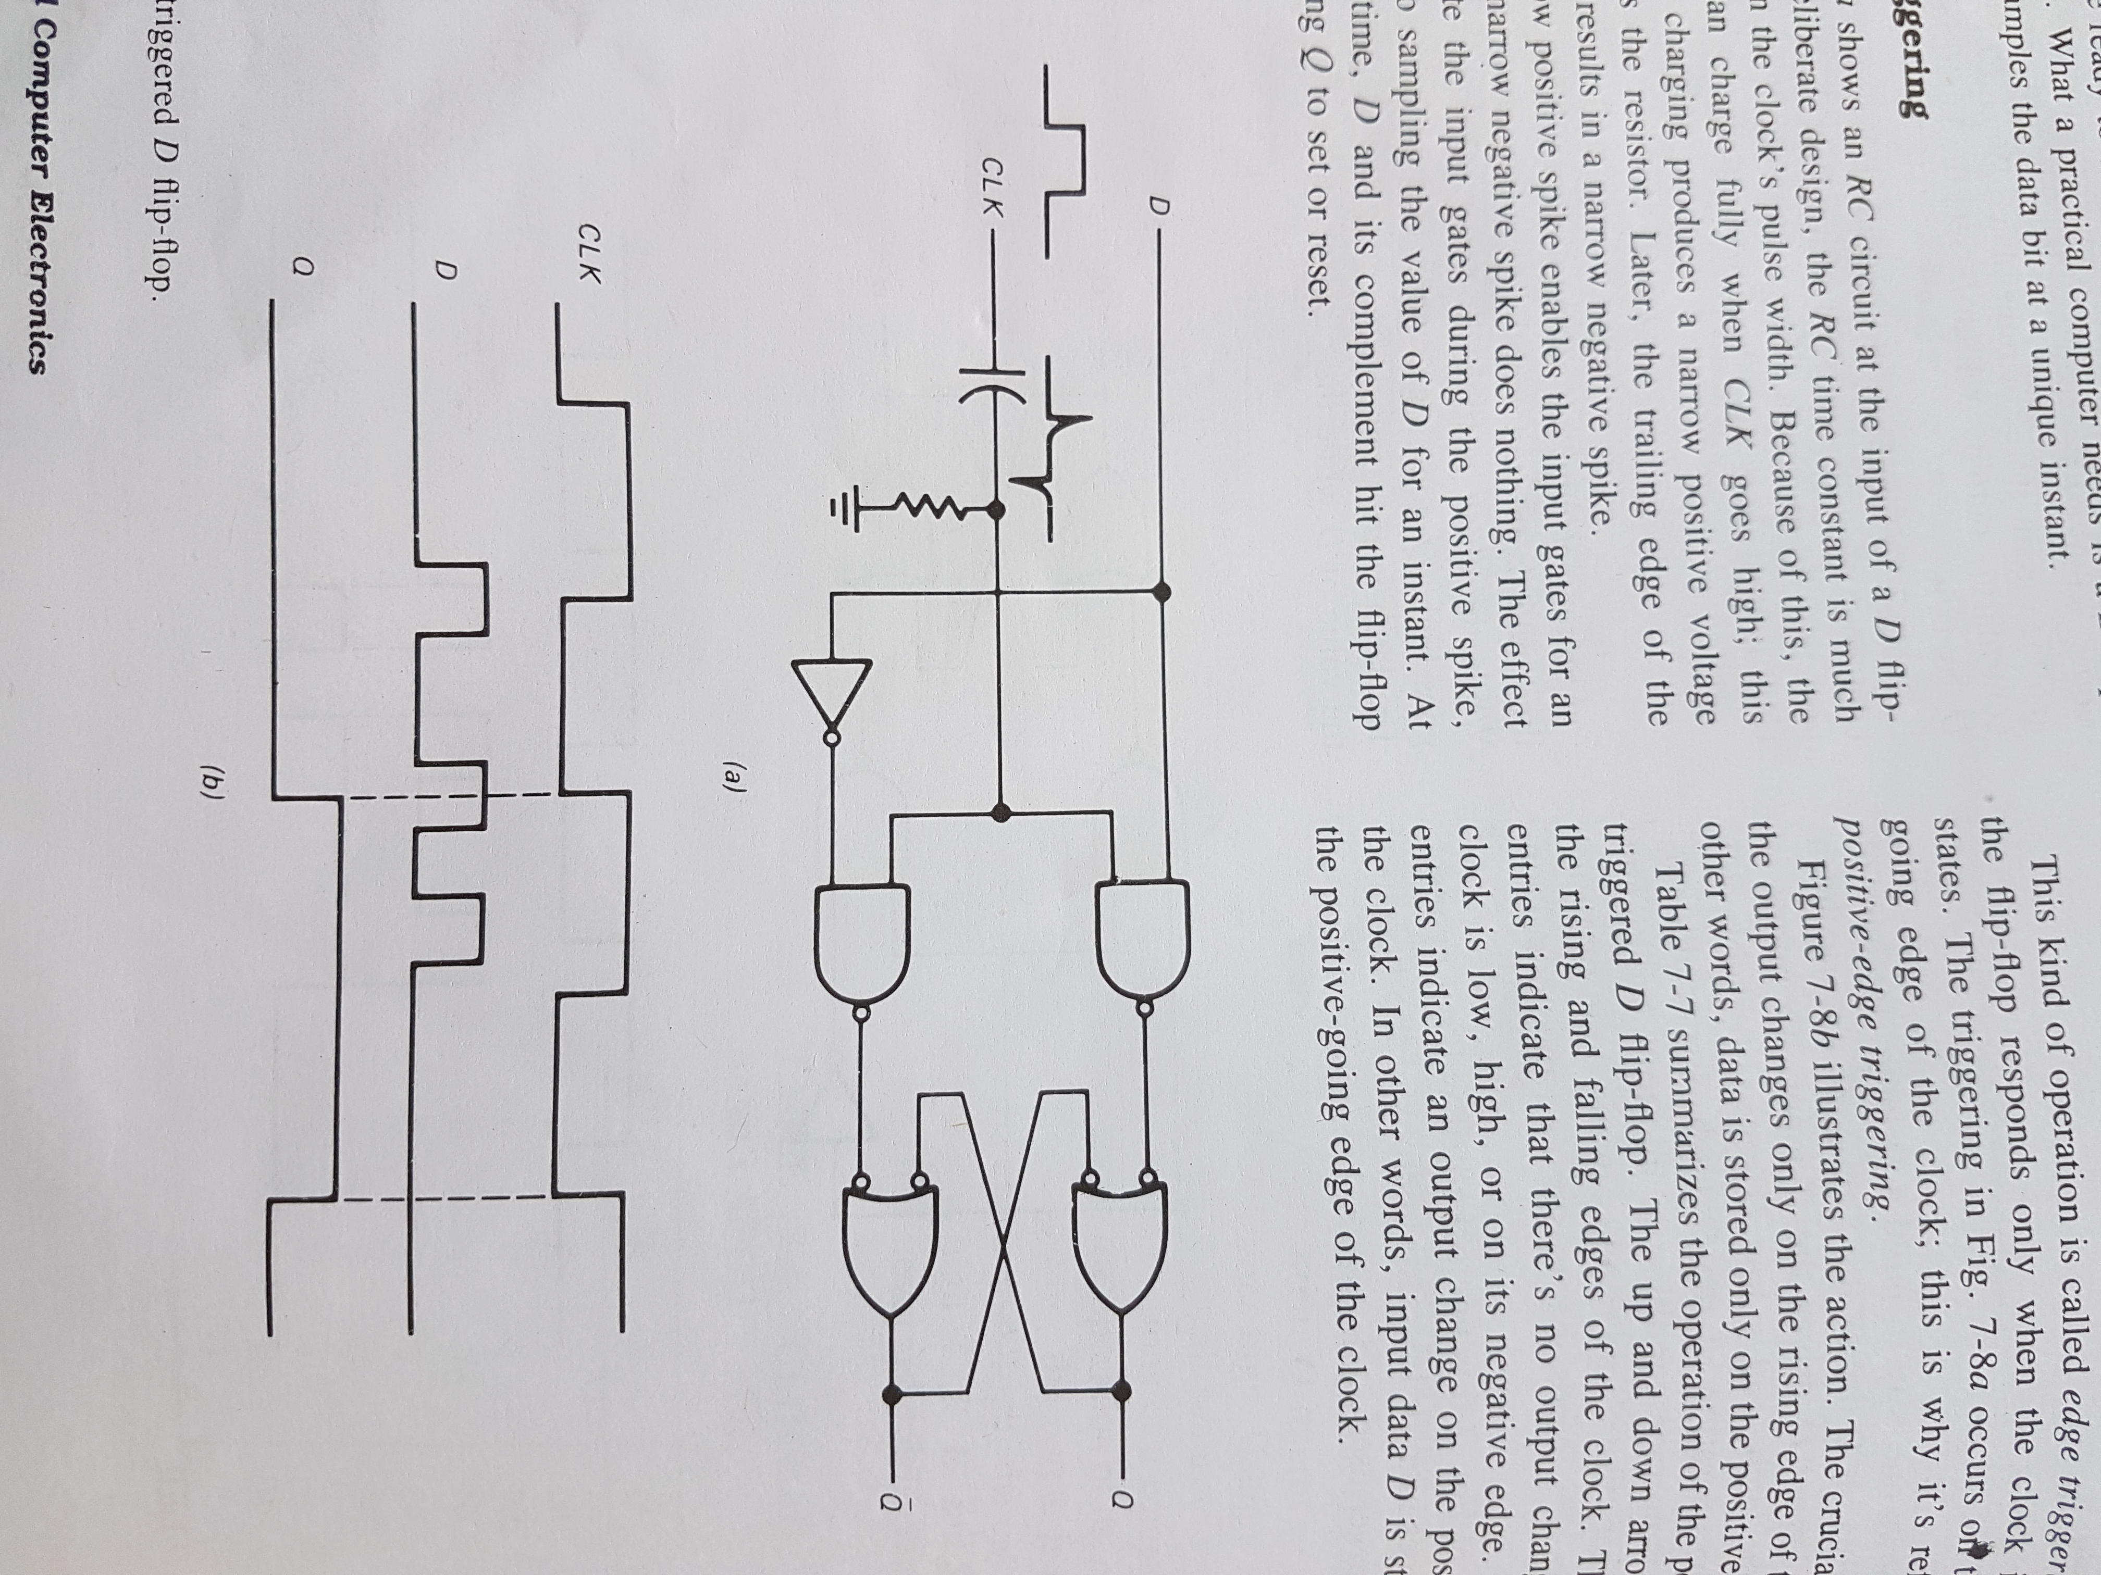
Edge triggering
Components Can be positive edge-triggered
or Negative edge-triggered
An example of positive edge-triggering with a RC
RC time constant much smaller than the clock cycle in the design

Slide 22
Edge triggering
In processors this won’t be done with RC circuits
Capacitors are too big, too difficult to fabricate on a chip…
Now the output can change only on the rising (or falling) edge of the clock
→ We sample the incoming data bit only at one instant during the clock cycle

Slide 23
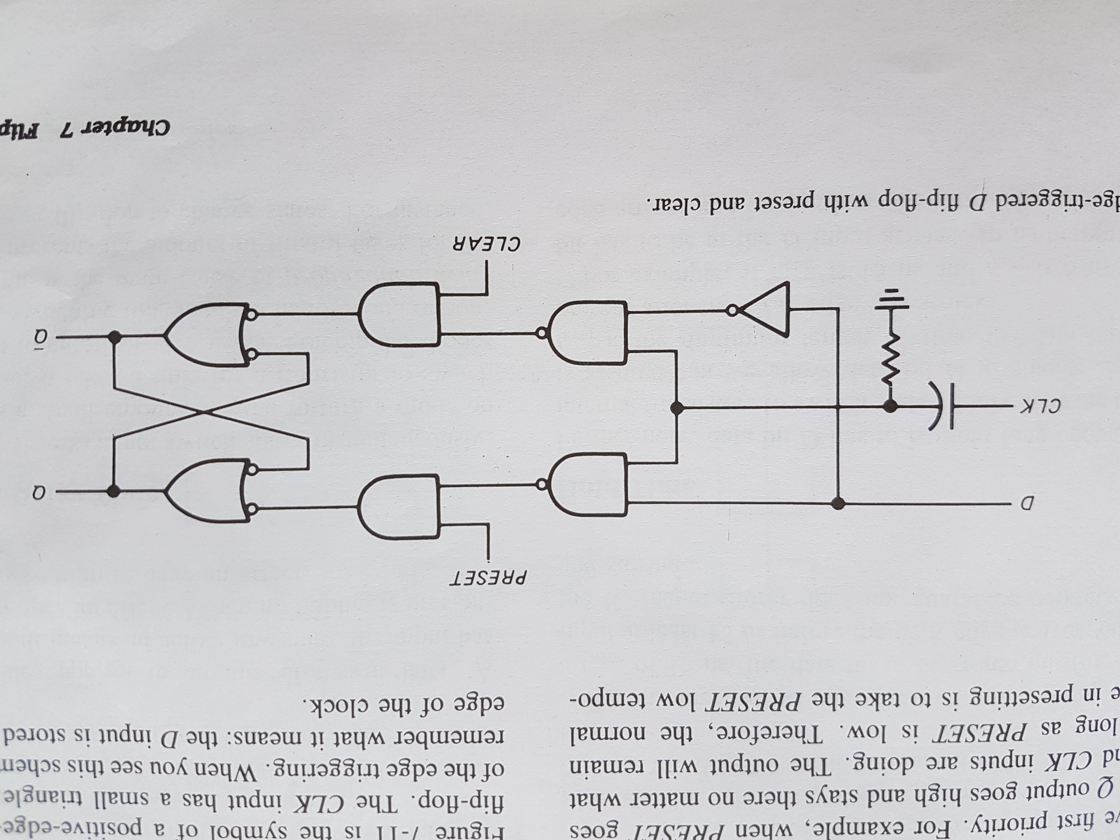
Preset and Reset/Clear

Slide 24
Preset at start up time
+VCC
+VCC
P
P

Slide 25
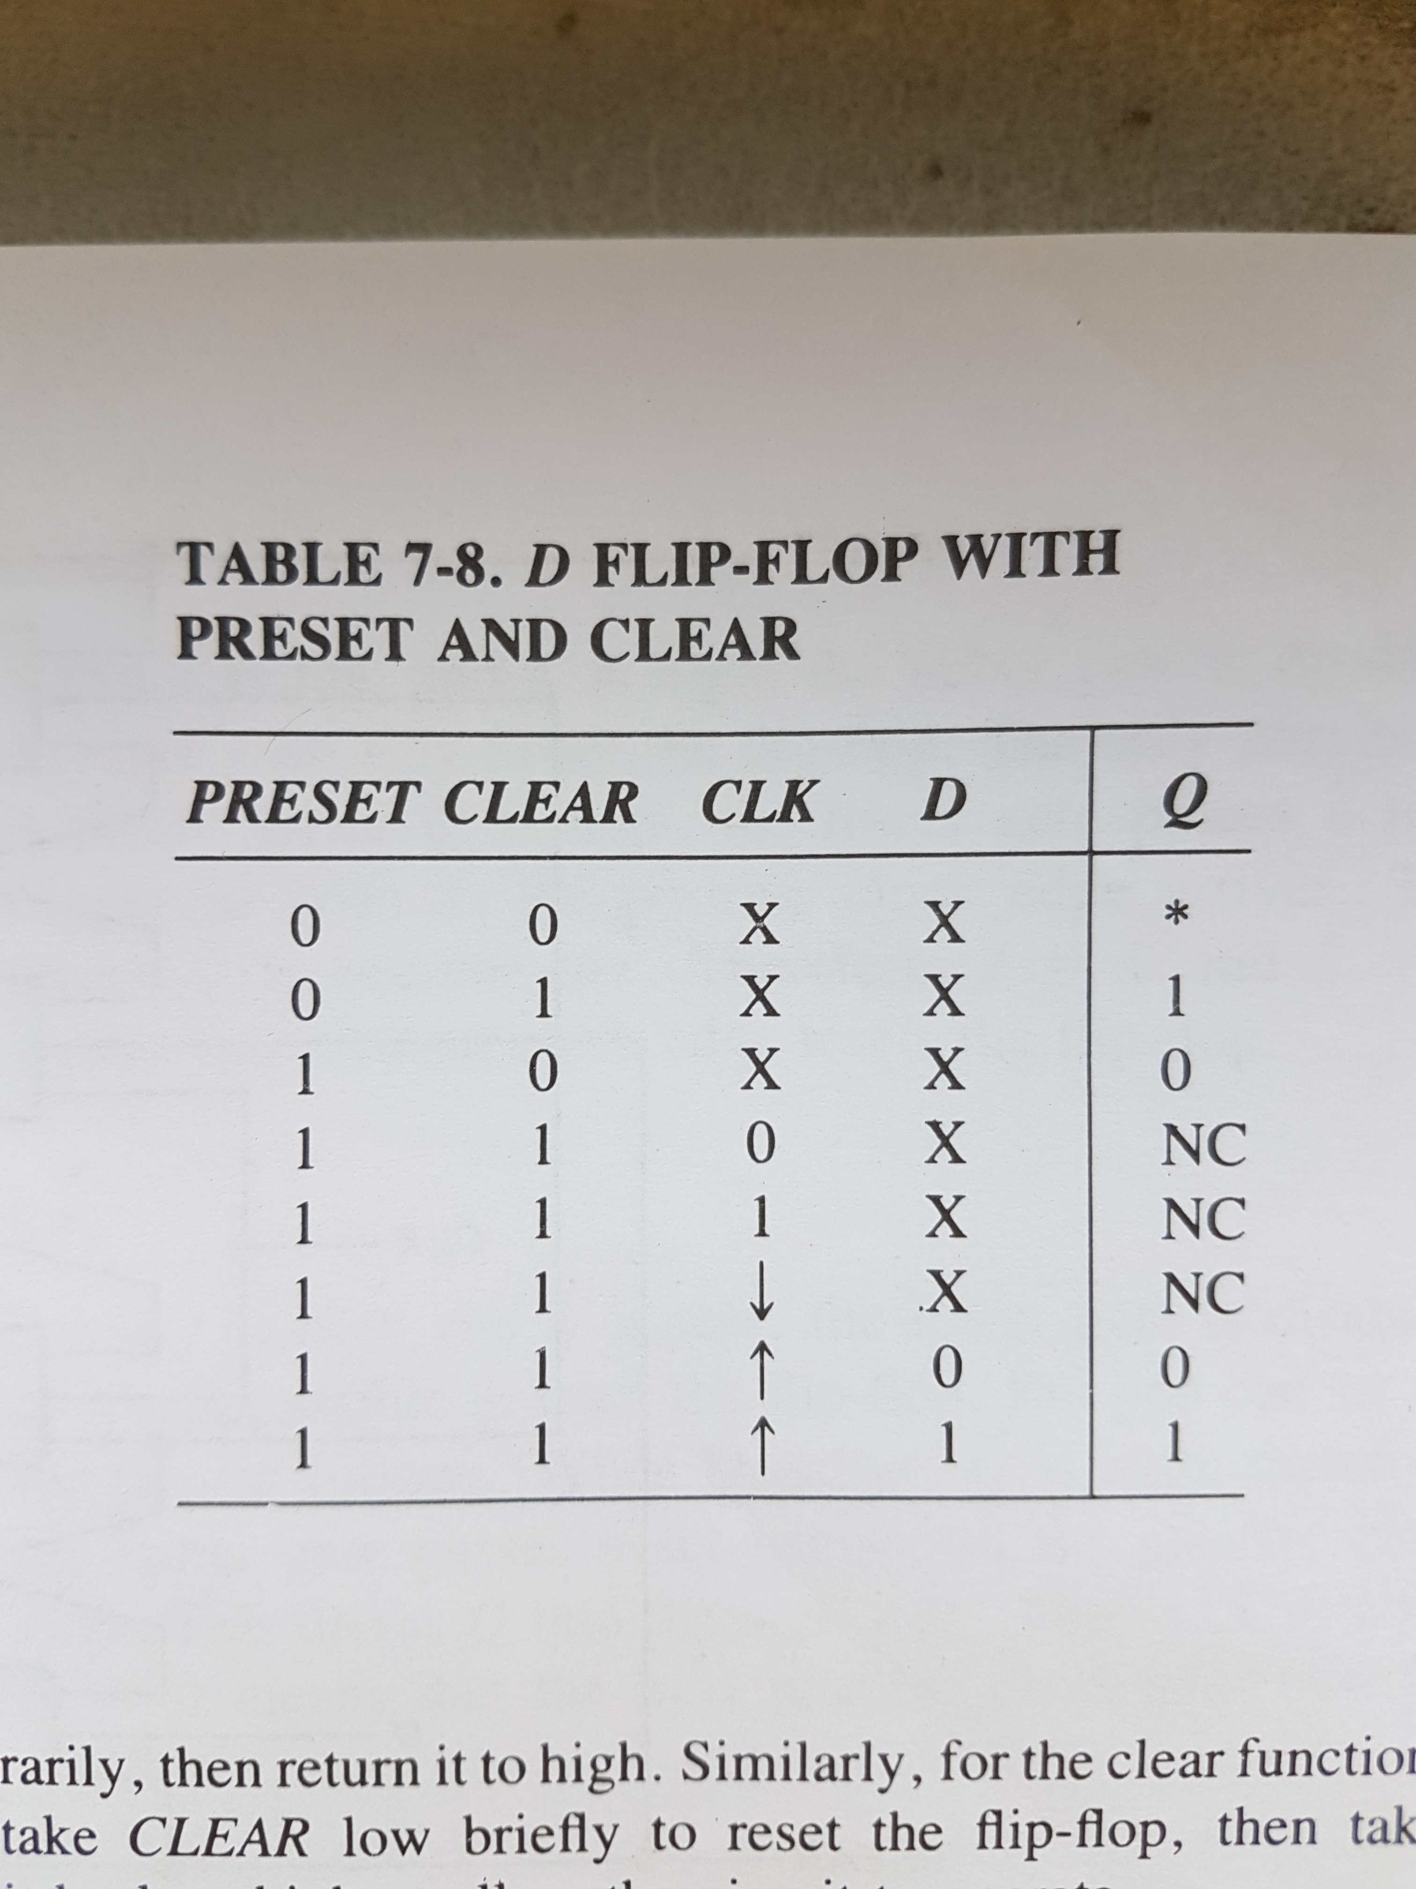

Slide 26
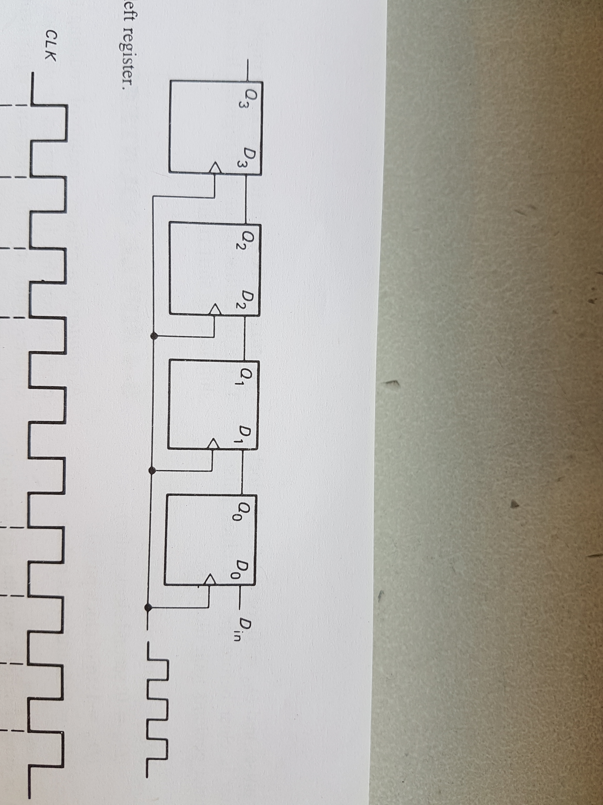
Registers
We know how to save one bit in our Latch, and its edge-triggered with the clock signal(raising or falling)
PRESET
CLEAR

Slide 27
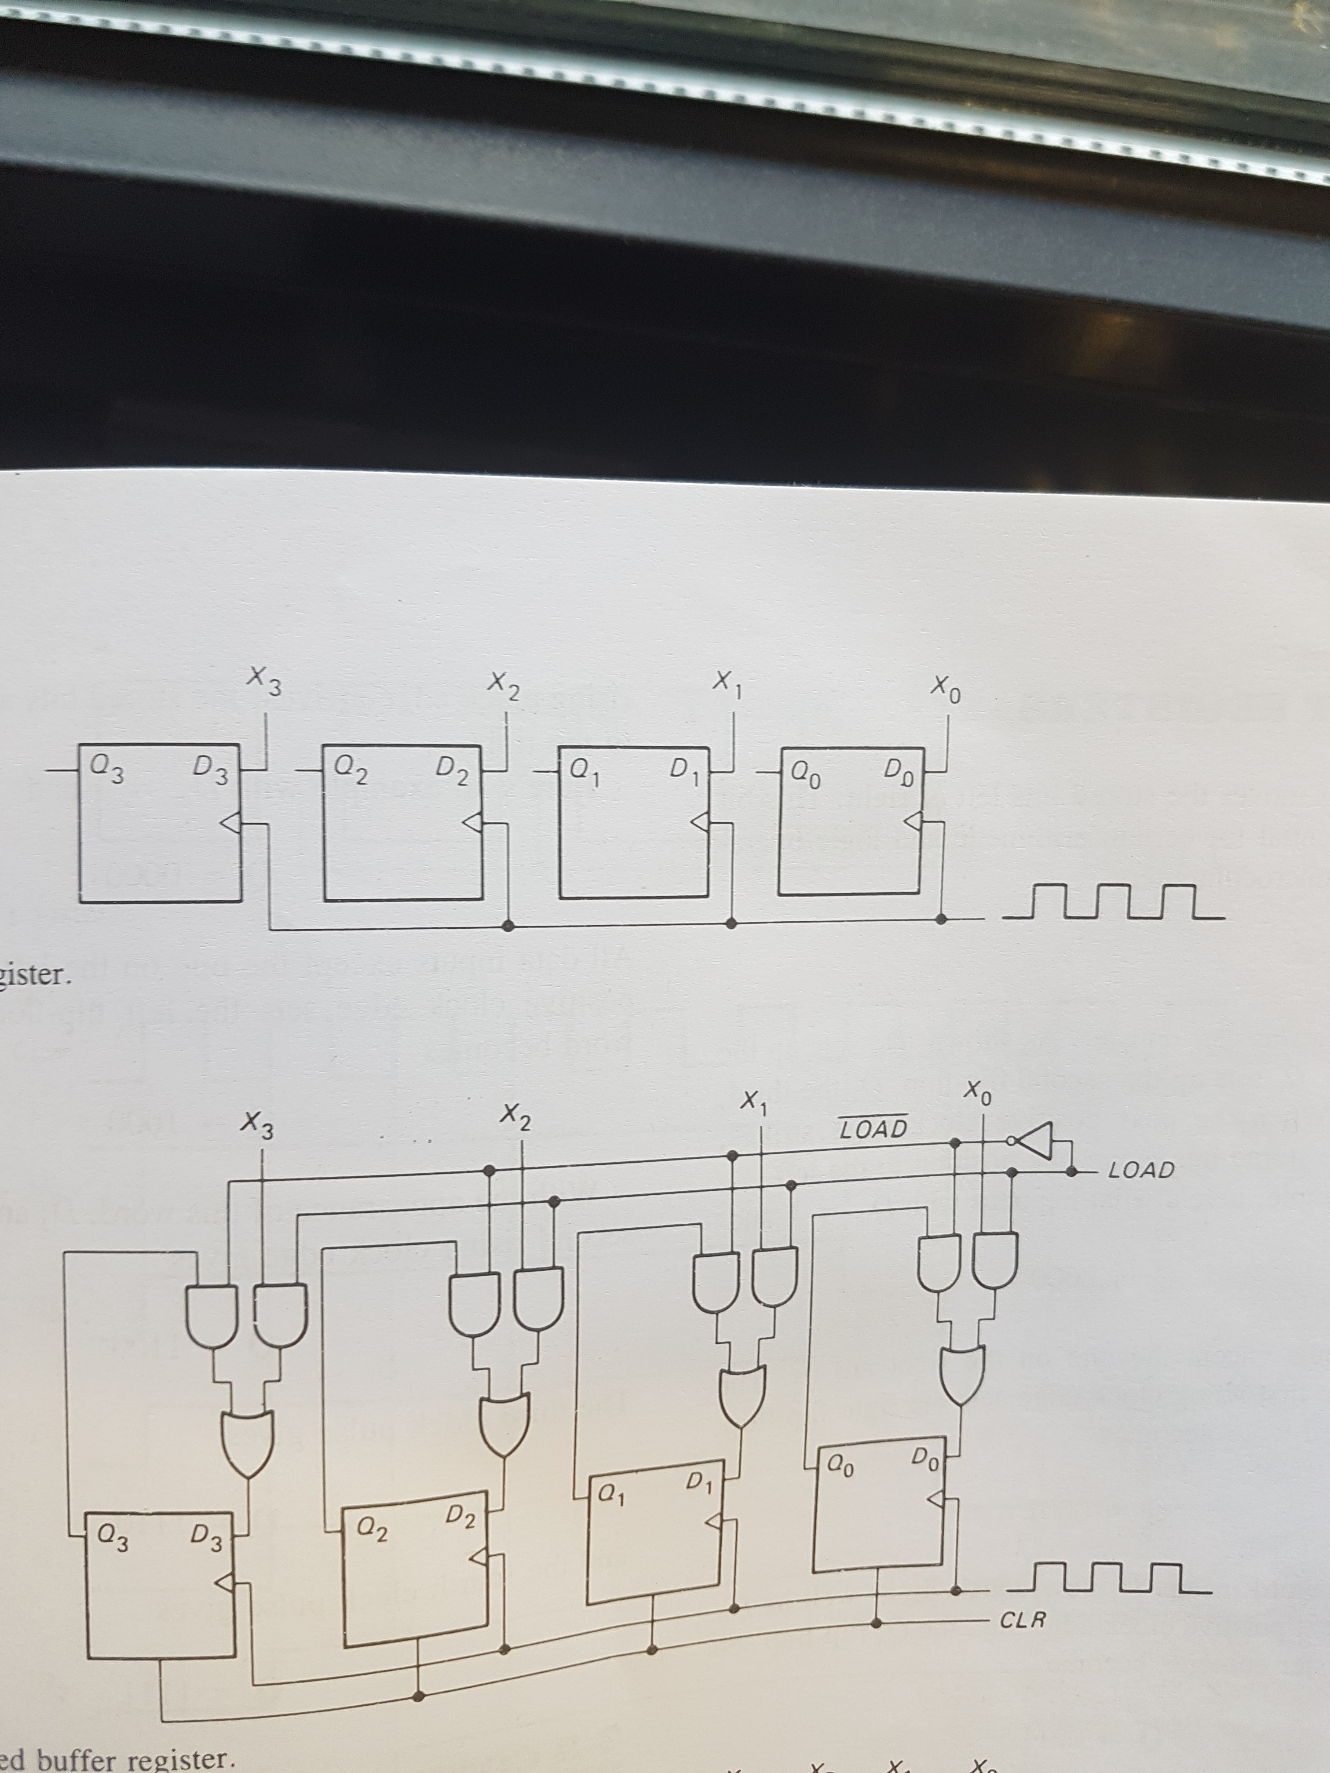
What is a register?
4 Bits

Slide 28
What is a Shift Register?
Common Clock
Q Output goes into the next Data IN

Slide 29
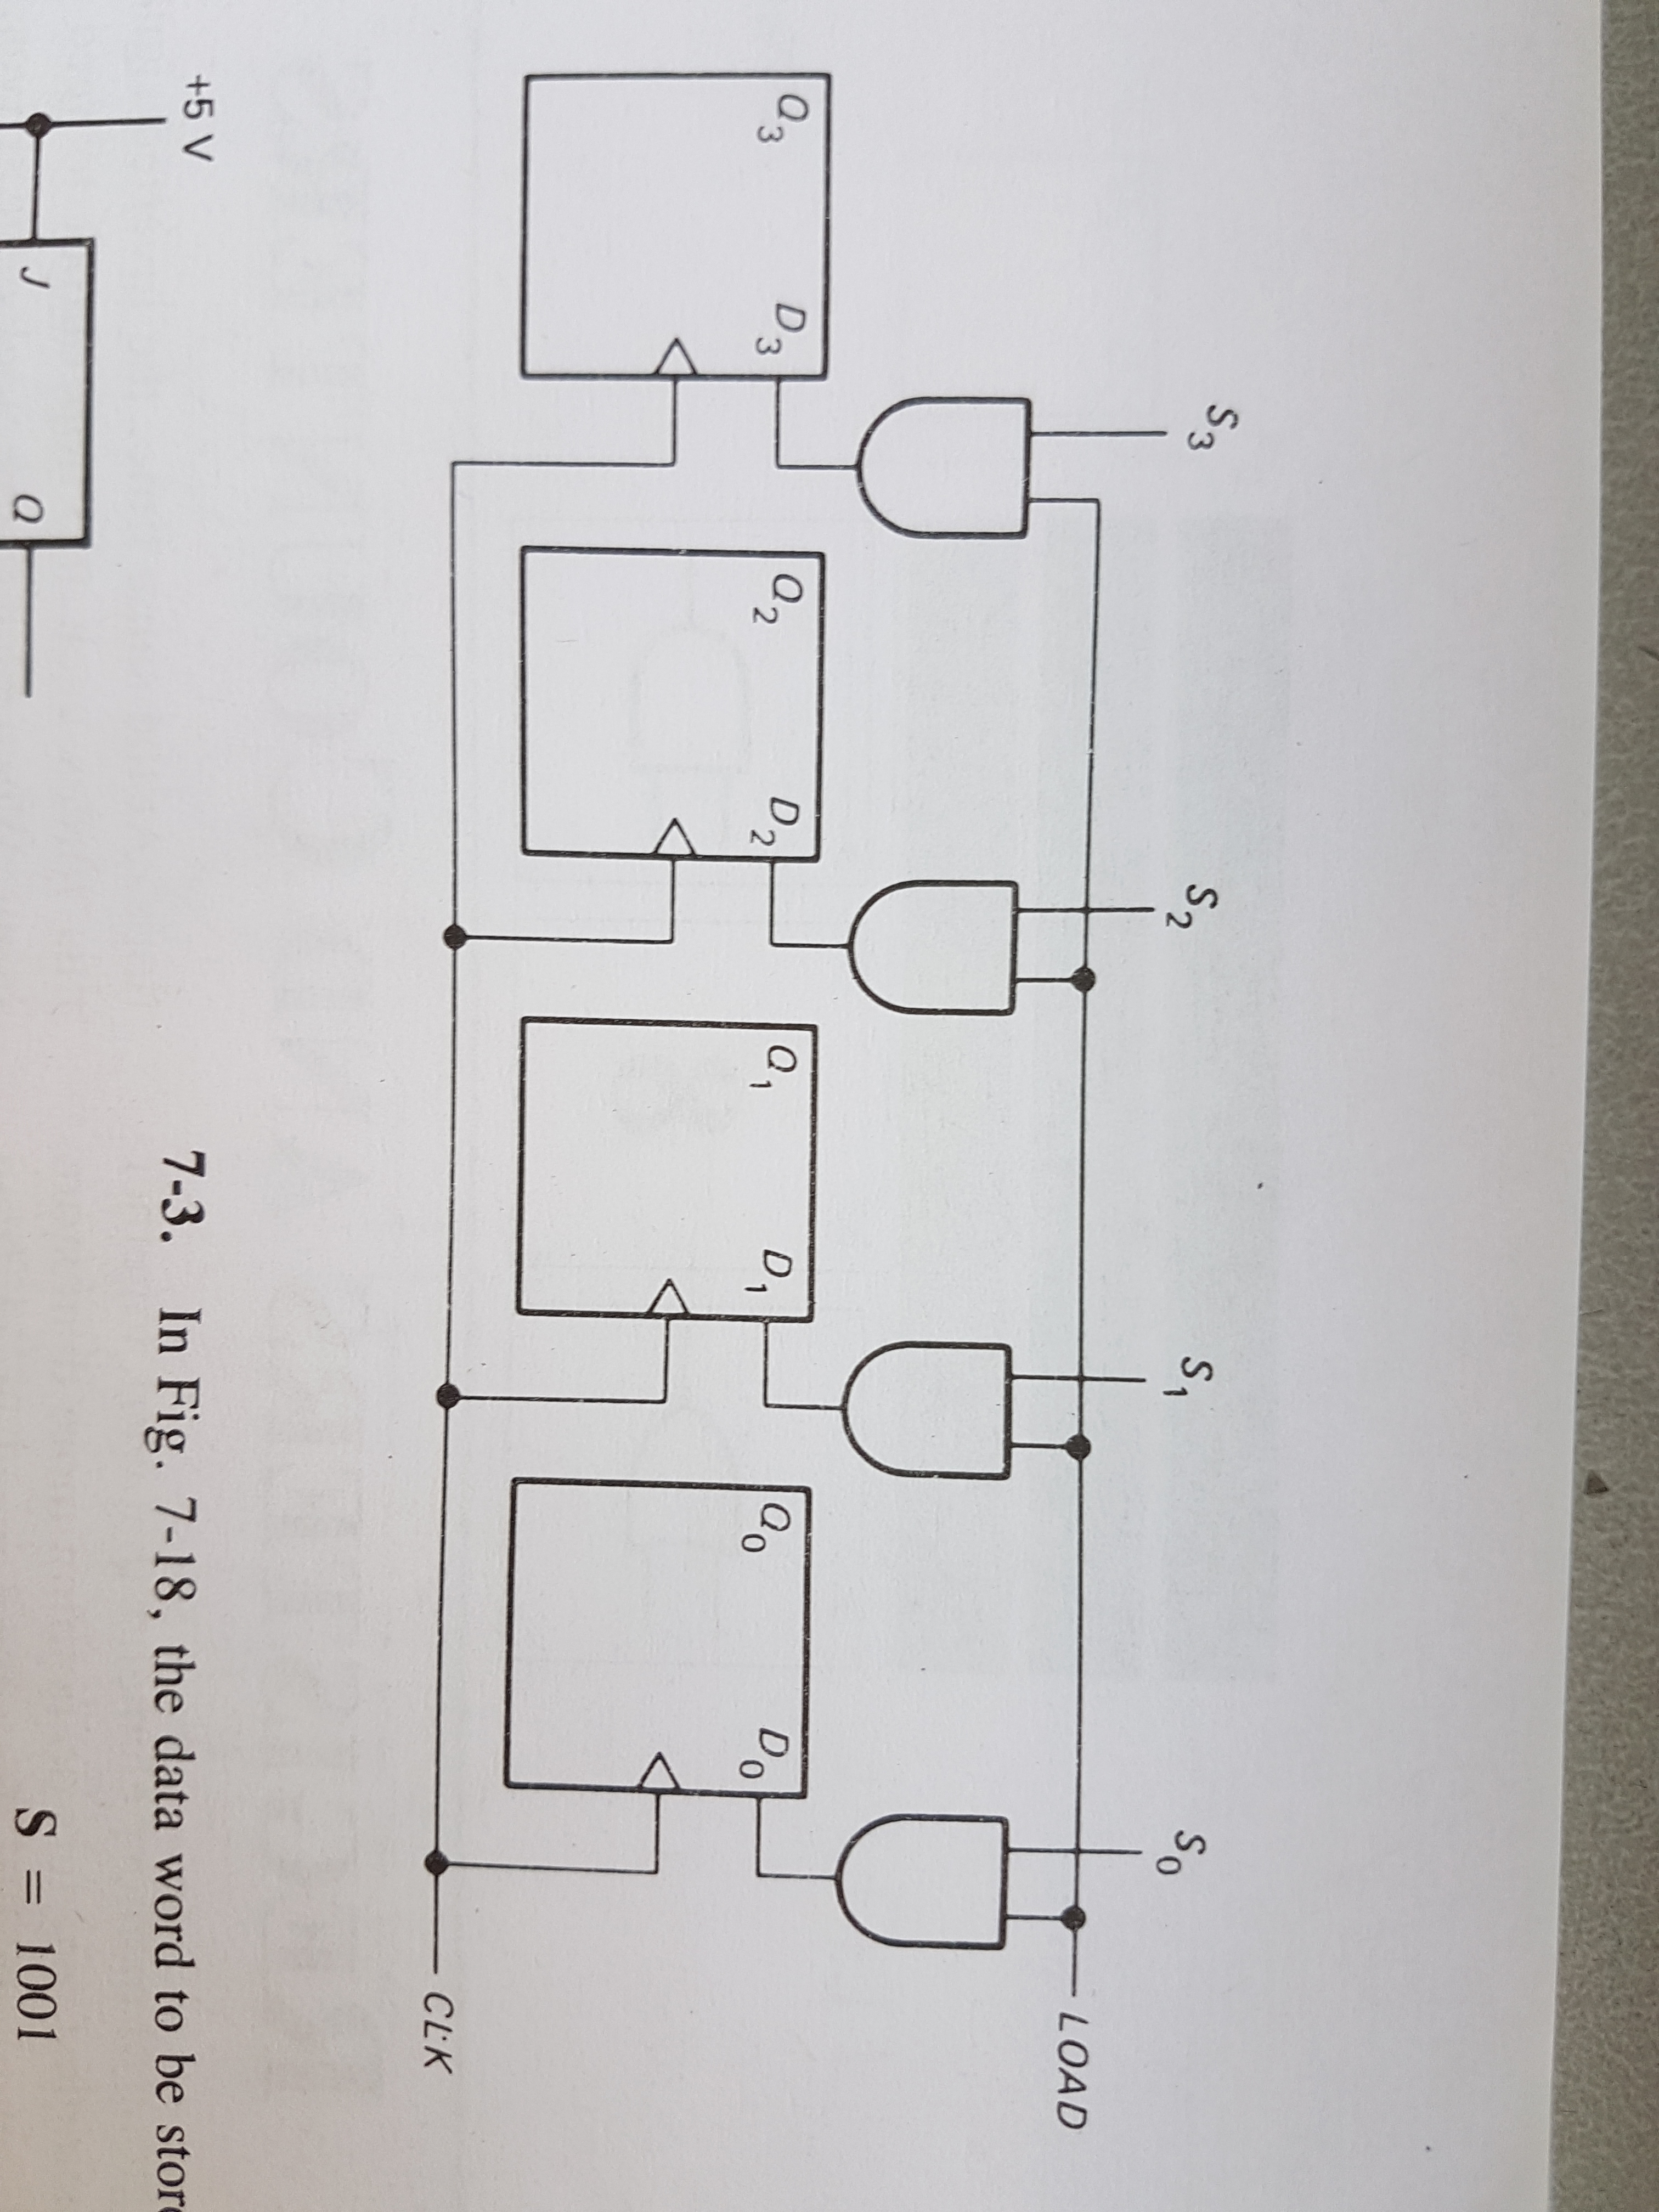
We can add control lines to our register
Ex: Load Data (usually “Latch enable” or “Store enable”)
Same logic for “OUTPUT ENABLE”, “PRESET”, ”CLEAR”…

Slide 30
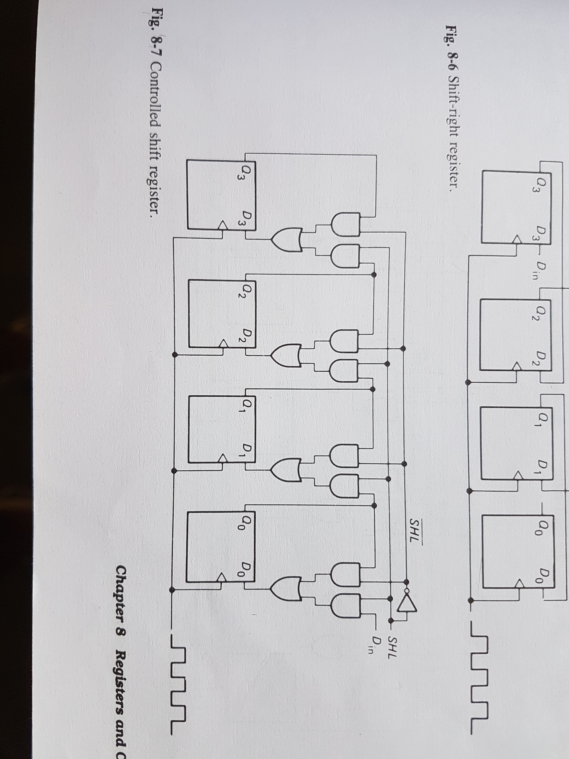
Controlled Shift register
OR

Slide 31
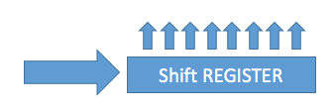
SIPO: Serial In Parallel Out
DATA OUT
DATA IN
CLOCK
PISO exists as well: Parallel In Serial out
Example: before sending information via UART protocol, it is stored into a buffer register in parallel at some point, then shifted out in serial

Slide 32
How may LEDs can you control?

Slide 33
Binary - 0 or 1 - WTF is the tri-state output?
+VCC
ENABLE
DATA IN
DATA OUT

Slide 34
Computer architecture insight
CLK
INPUT
A
MEMORY A
A
OUTPUT
Selected line
INPUT
MEMORY B
DATA BUS
OUTPUT
ADDRESS BUS
INPUT
MEMORY C
OUTPUT
A
INPUT
D
MEMORY
OUTPUT
Selected line

Slide 35


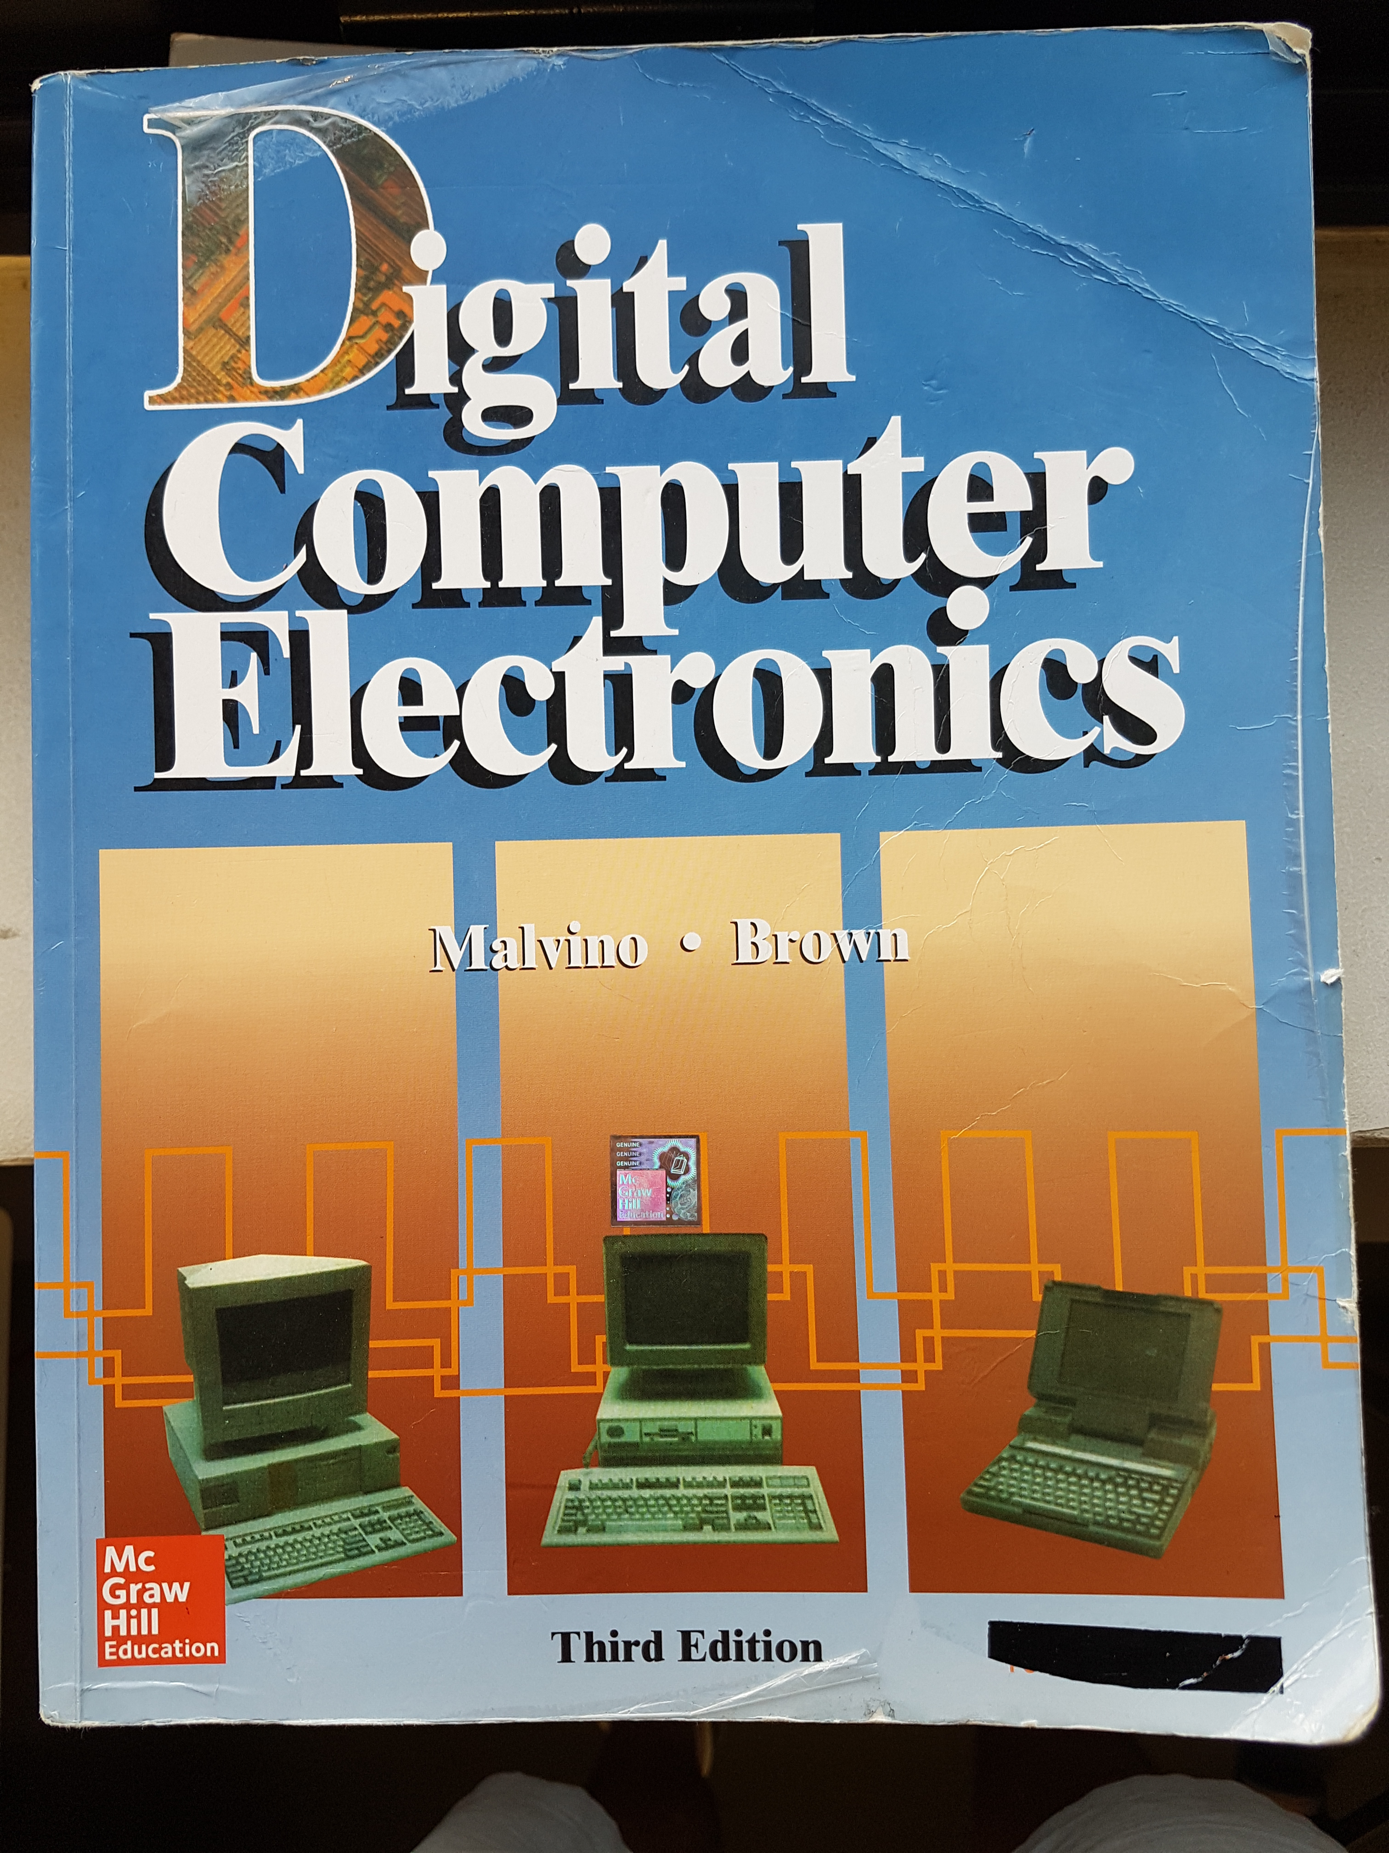
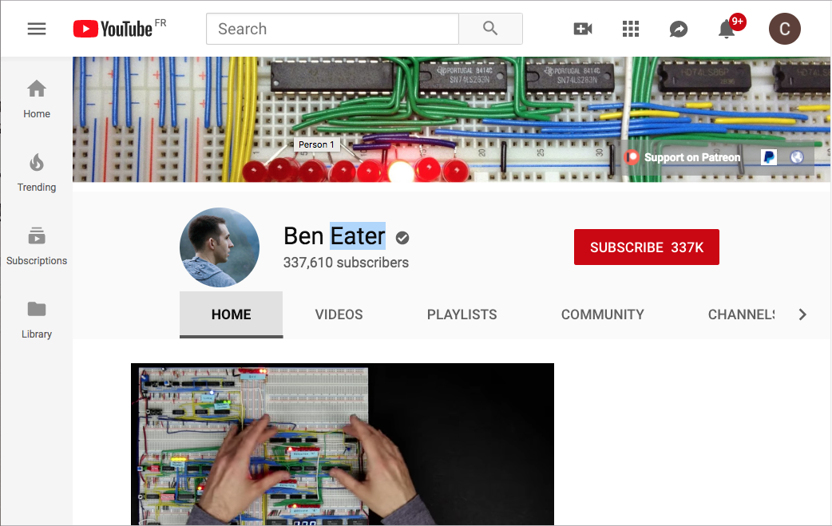
Sources

Slide 36
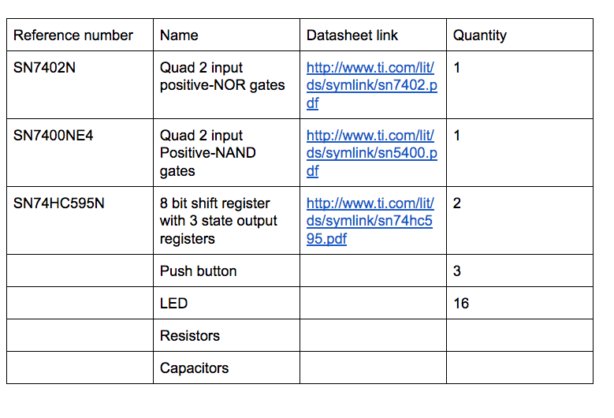
Lab Work / TP : components

Slide 37
TP todo list
https://github.com/charMstr/Save_a_bit_Shift_bits_Blink_100_ledss.git

Slide 38




Pendant ce temps là

Slide 39

charmstr

